Slide 1
mDOT_chan0b Test
Kalle Sulanke
May 2020

Slide 2
Introduction
Available now: 4 x mDOT_chan0b + 5 x mDOT_chan0, assembled by Mandy Hemp
chan0b almost identical with chan0, except
Optional, extra DAC channel could be used to tune the preamps working point
Not used presently
additional input and improved ADC protection
Present tests with bigger time constant for the pulse shaper
91ohm x 100pF instead of 49.9ohm x 100pF (like at chan0 and chan2)

Slide 3
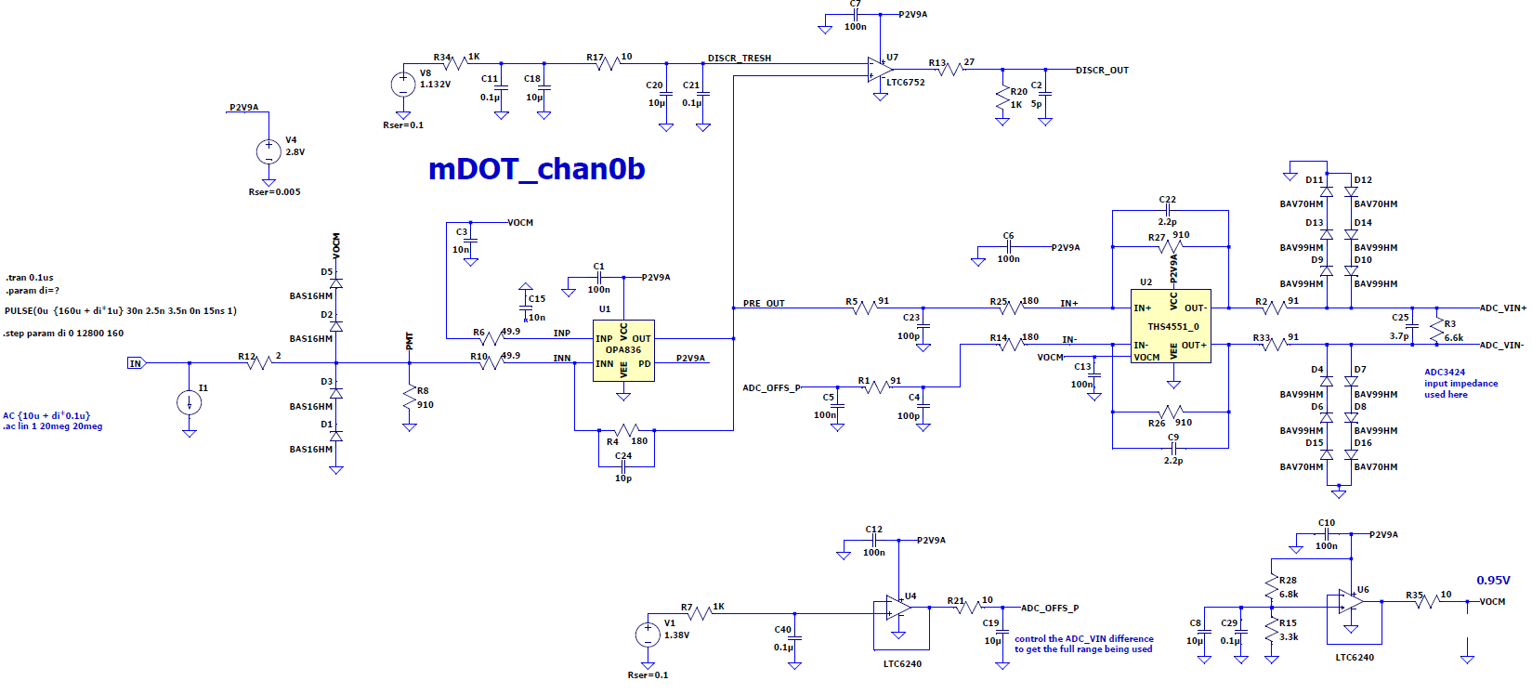
LTSpice Schematic
time constant

Slide 4
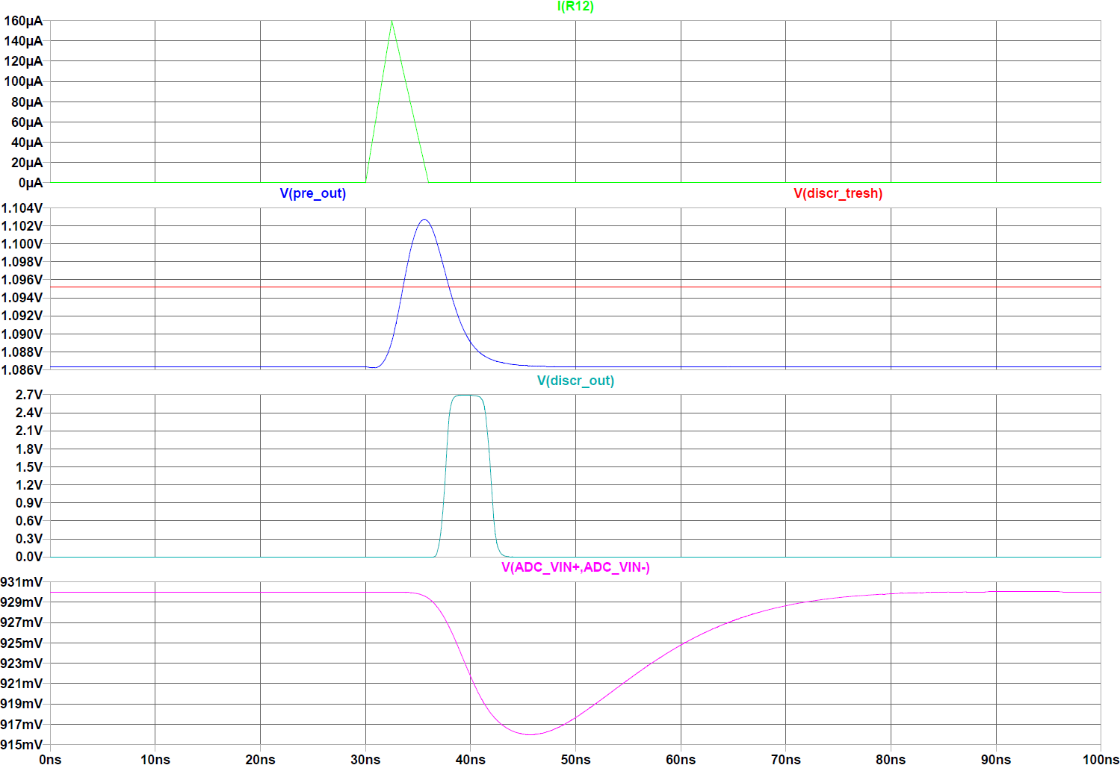
SPE Signal, LTSpice Simulation, 1SPE
29
ADC bins

Slide 5
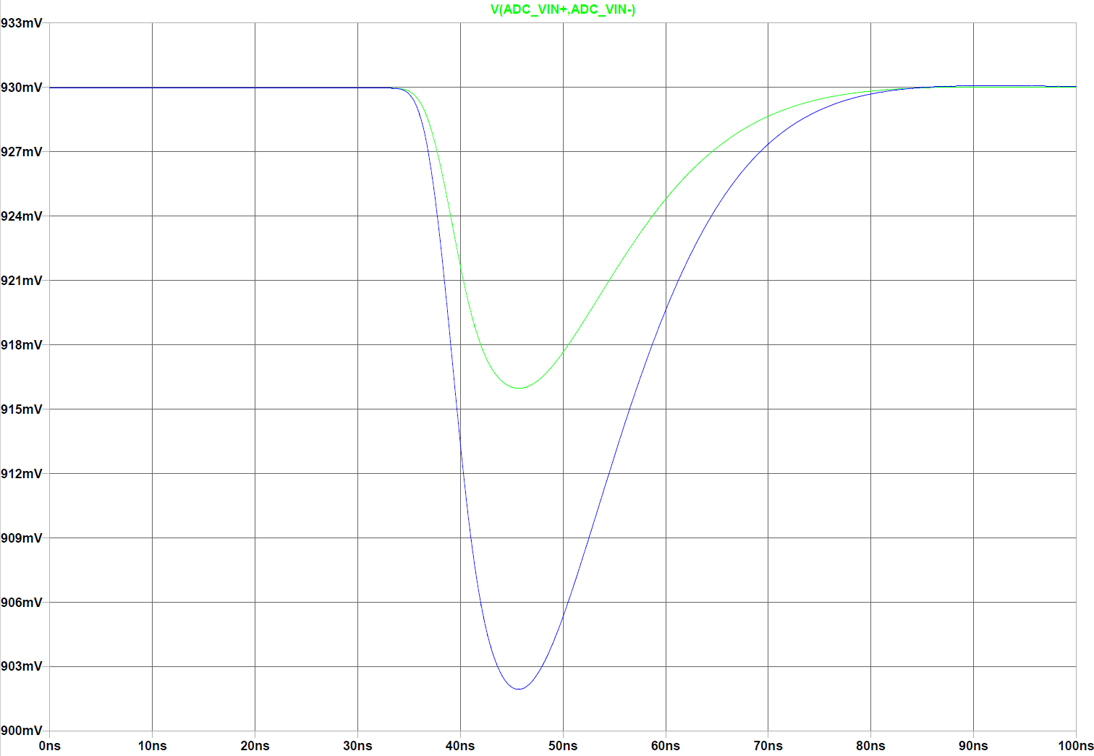
SPE Signal, LTSpice Simulation, 1-2 SPE
ADC_in
1SPE
58
ADC bins
2SPE

Slide 6
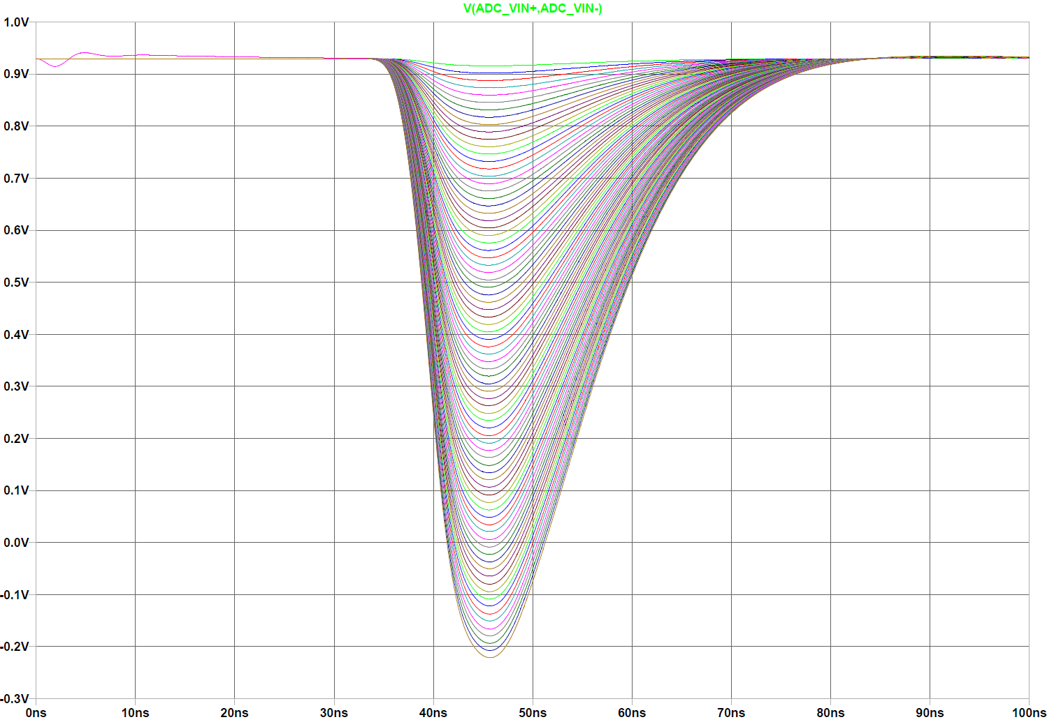
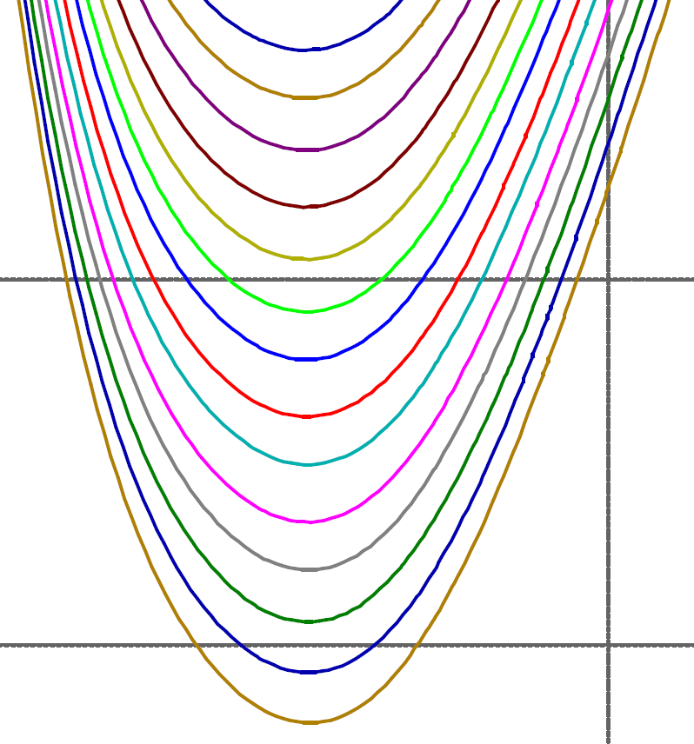
SPE Signal, LTSpice Simulation, 1-80 SPE, Linearity
ADC_in
2396 ADC bins
Linearity, zoomed view

Slide 7
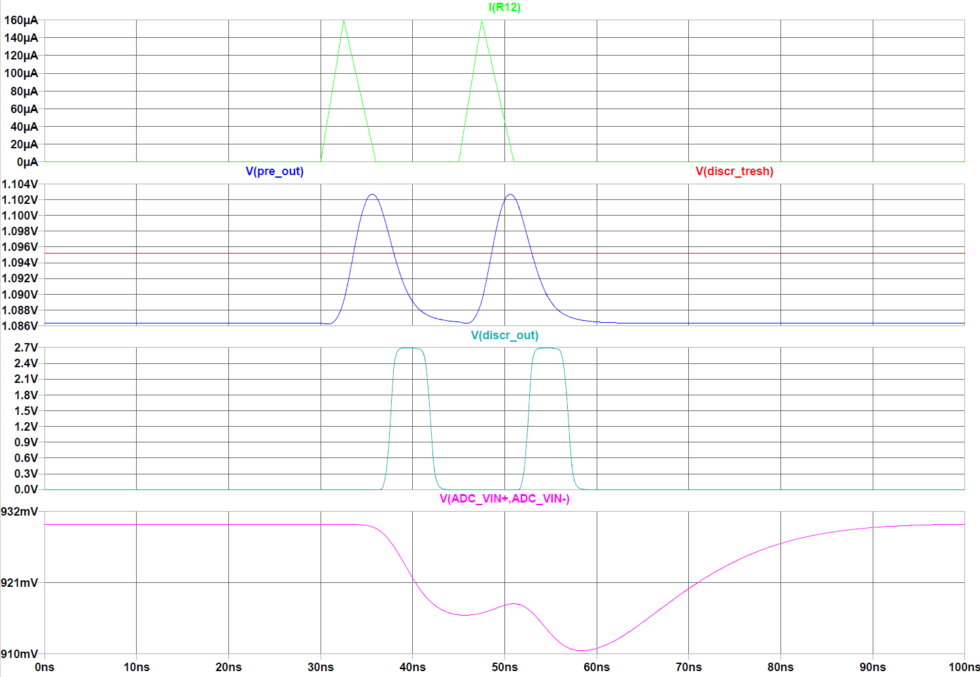
SPE Signal, LTSpice Simulation, 2x 1SPE, 15ns

Slide 8
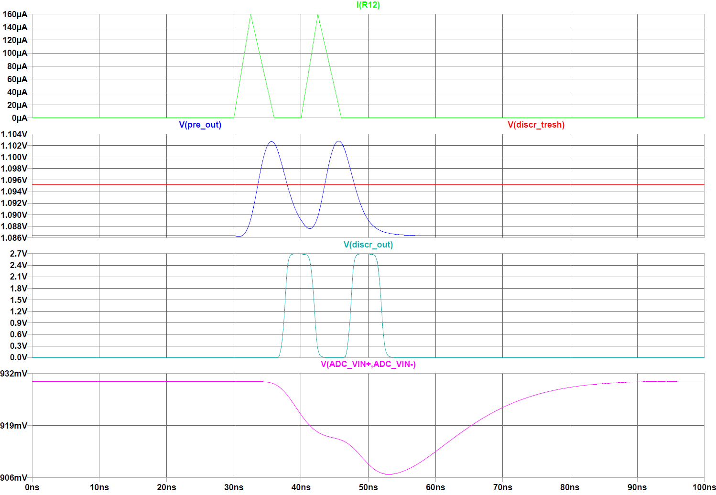
SPE Signal, LTSpice Simulation, 2x 1SPE, 10ns

Slide 9
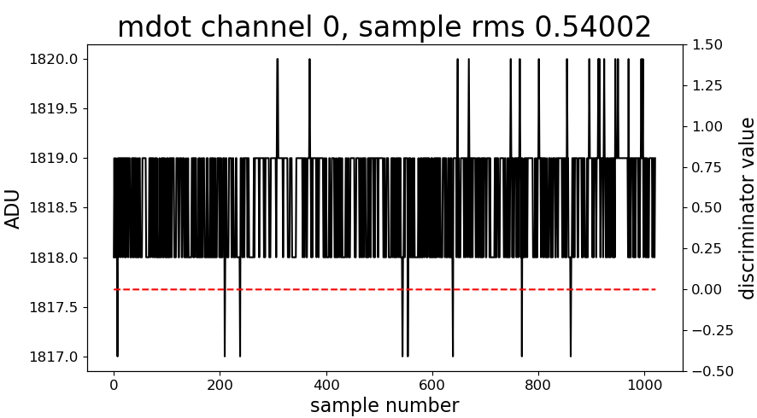
Typical noise, with open input
Rin=910R, Rn = 180R, Cn=610p, LP = 91R x 100p, gain_2 ~ 5, DAC0_e = 37000, DAC1_a = 37200

Slide 10
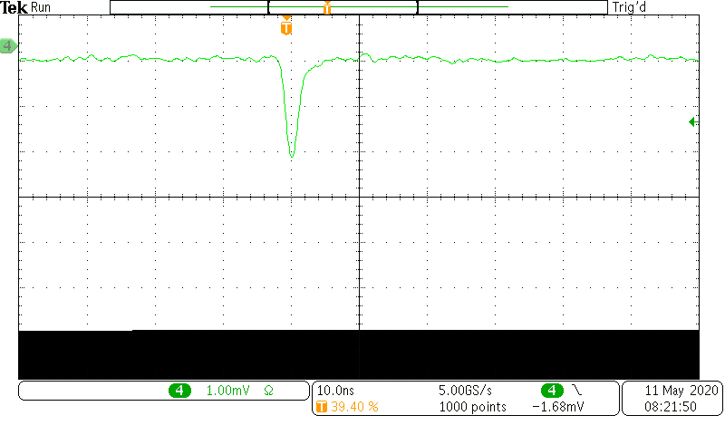
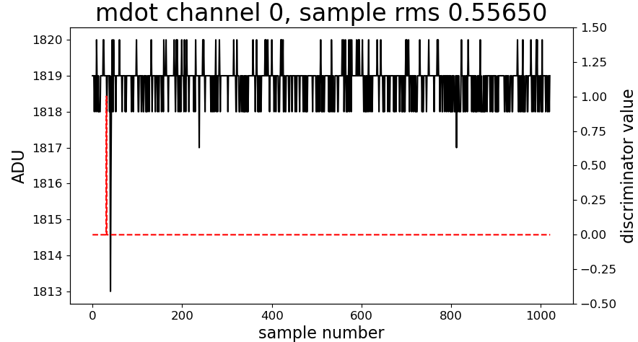
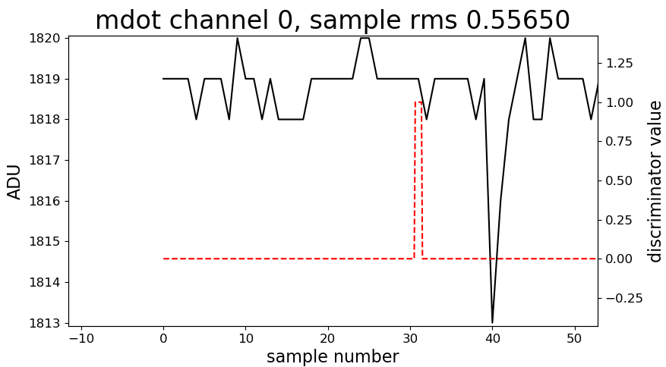
1/4 SPE input (2mV pk)
6
100% trigger rate

Slide 11
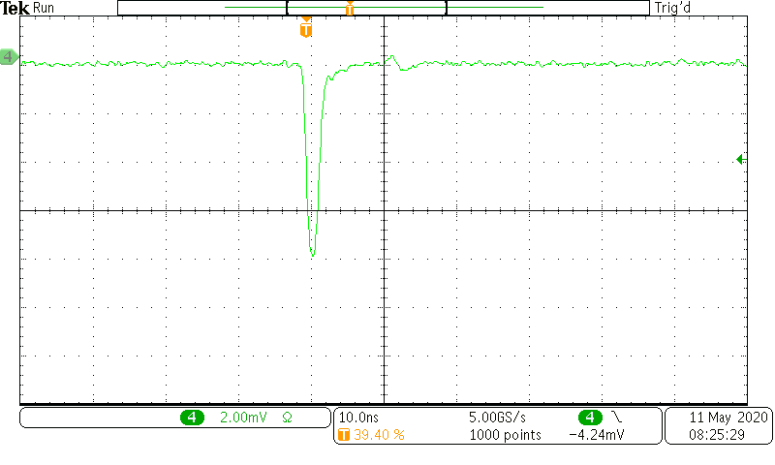
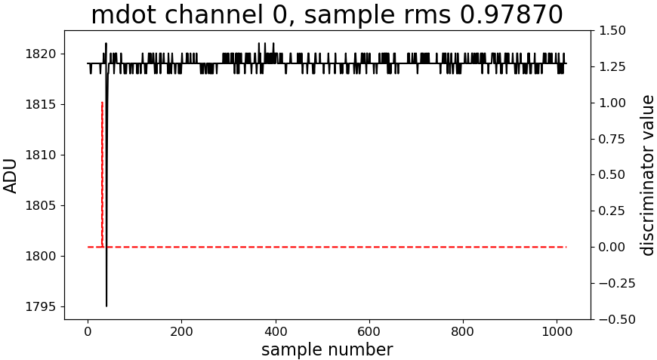
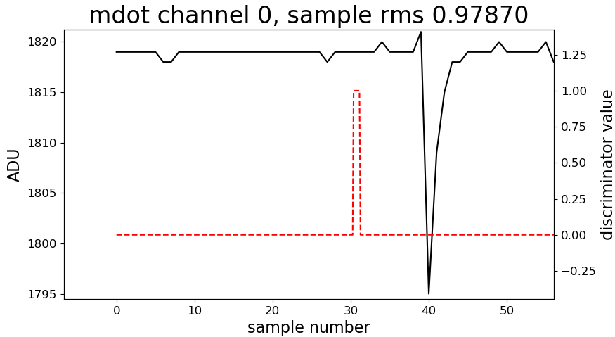
1SPE input (8mV pk)
24

Slide 12
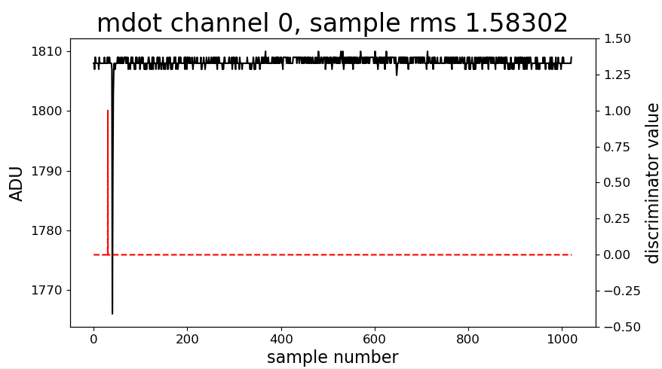
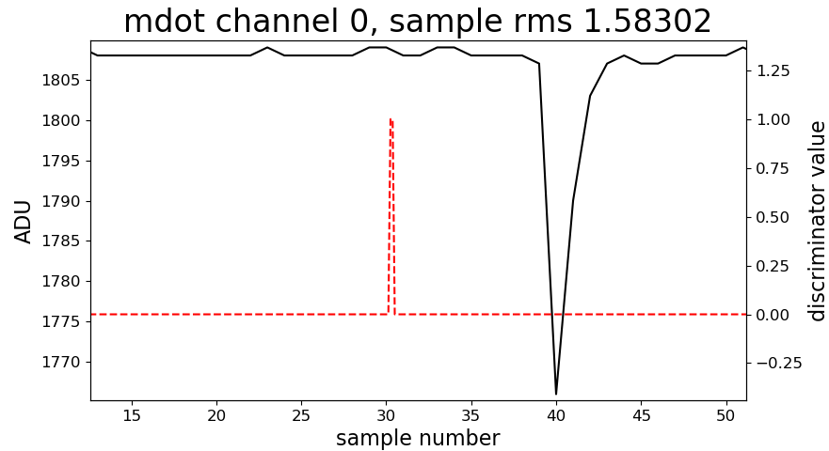
PMT signal, HV = 800V, discr_thr = 1SPE
PMT-Testbox used
R5900-3-M4
Typ. HV: 800 +/-50V
42

Slide 13
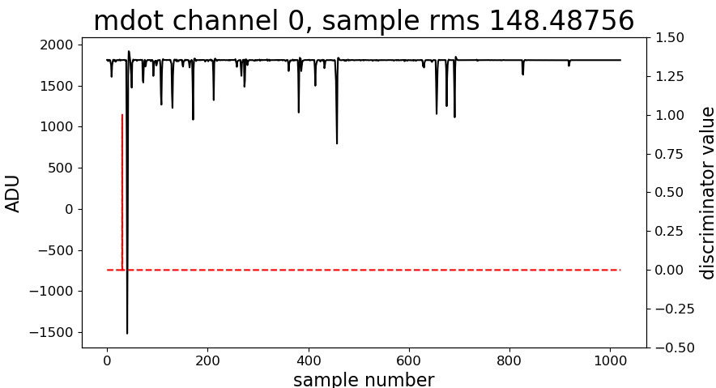
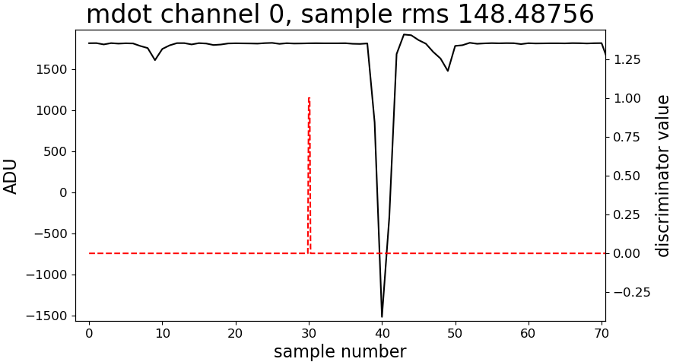
PMT signal, HV = 1000V (!), discr_thr = very high
PMT-Testbox used
R5900-3-M4
Typ. HV: 800 +/-50V
DAC1_a = 55000
3300

Slide 14
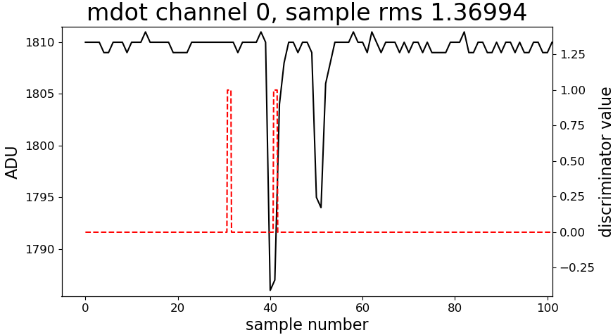
Double Pulse, HV = 800V, discr_thr = 0.1 SPE
PMT-Testbox used

Slide 15
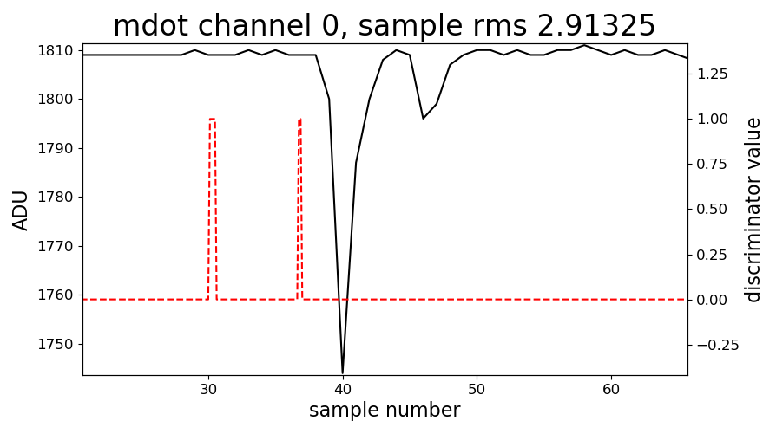
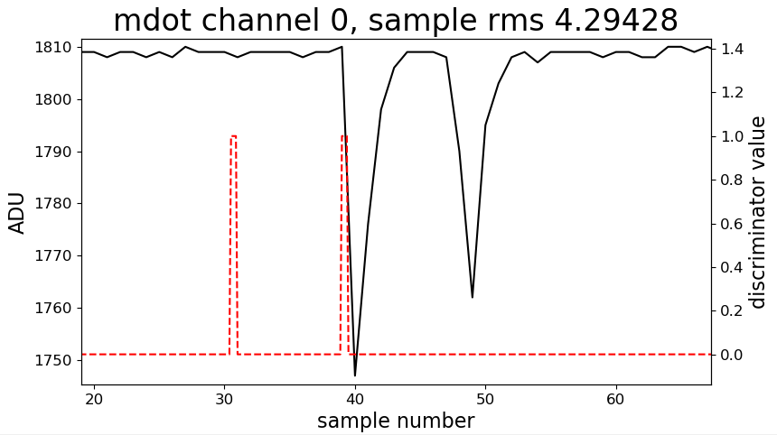
Double Pulse, HV = 900V, discr_thr = 0.25 SPE
PMT-Testbox used

