Slide 1
Front End Design for the mDOM Mainbord
Kalle Sulanke
April 2020

Slide 2
Introduction
mDOT = mDOM Testboard
4 different analog channels, optimized for very low power
Trade off with bandwidth
ADC Sampling rate is 100MSPS (max. is 125 MSPS)
Pulse shaping required
At channel #0,2,3, looking for:
ADC baseline noise
Minimum signal level required, to get a trigger
Dynamic range
Power consumption

Slide 3
mDOT Blockdiagram
USB2_+5V
+5V
DC/DC
LT8602
Xilinx FPGA
Power
jumper
XC7S25-2FTGB196I
DC/DC
THN 15-7211WIR
ADC
ADC3424
Preamp
PMT
iserdes
Comp
ADCMP601
43-160V
analog_chan_0..3
DC
5V
ICM
DAC
LTC2600
Filter
SPI
PCA
AC
rx/tx
dom_addr
uart
clock
uart
HV-Ctrl
HV-Ctrl 1..24
DOM_ID
1-wire
sync
HV-Ctrl
USB1
JTAG
JTAG
MCU-signals
trig
LED
flasher
SPI
DAC
LTC2600
Test-Pins
USB2
bridge
FT232RQ
uart
+3.3V
DC/DC
LT3494
LED_+16V
Config. Flash
MT25QU512
QOSC
ML602-020.0M
clock_qosc
I2C
Temp.
TMP116
Pressure
DPS310
Compass
LISL3MDL

Slide 4
Test Setup
mini_Fieldhub + 1.5m cable + mDOT
mDOT firmware by Tyler Anderson, Aaron Fienberg
Python scripts by Aaron Fienberg and Timo Karg
Pulse generator Stanford DG 645, to get faked PMT pulses
Plus attenuator, 0 to 40 dB
Tektronix scope MDO3104
Self made isolating analog coupler, amplitudes from 1mV pk to 0.35V pk
Based on RF transformer ADT1-1WT (0.4 to 800MHz bandwidth)
To avoid DC/DC noise by capacitive coupled ground loops
Massive, light-tight aluminum box (BERNSTEIN CA-480)
600 x 310 x 180 mm, 4 mm wall thickness

Slide 5
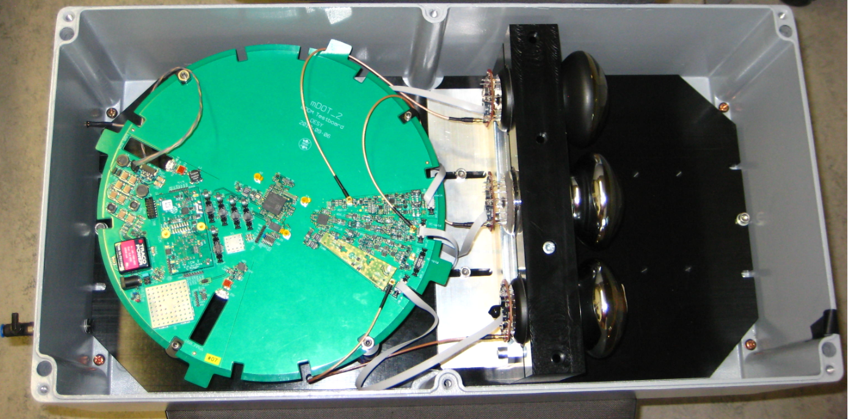
Test Box
channels 0, 2, 3 connected, setup also used for the first cold tests
Chan_3
Base 2.4
Chan_2
Base 2.4
#3
#2
#0
Chan_0
Base 2.1

Slide 6
Original mDOT Channels #1, #2
Original channels #1 and #2 have a bit weak preamplifier stages
Therefore channel #2 modified
These modification resulted in the design of channel #0 (piggyback)
Shown test results basically focus on channel #3 and #0
Channel #3 designed and simulated by Axel Kretschmann
For optimization, several test boards have been used in the past

Slide 7
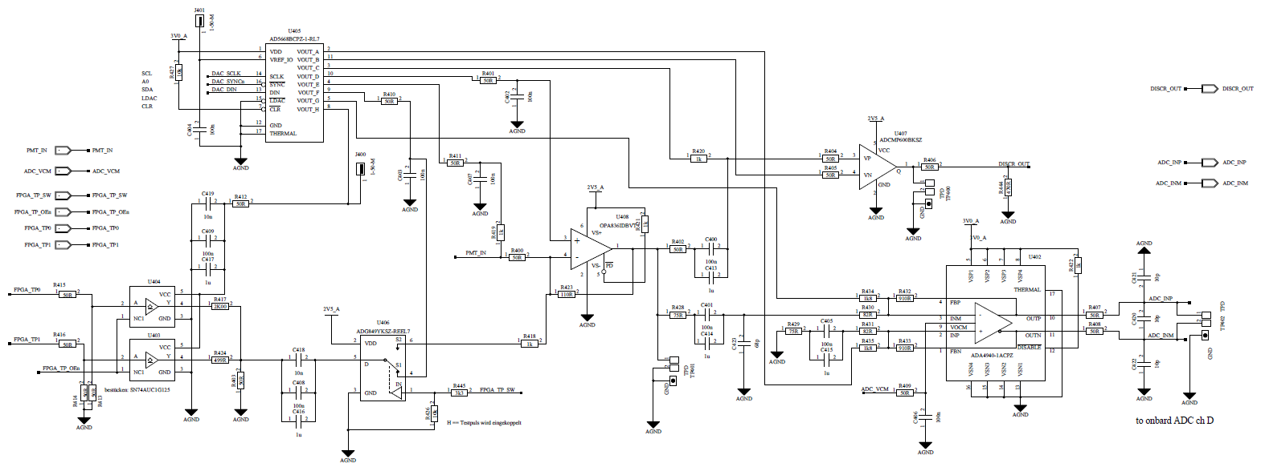
Channel #3, Schematic (by Axel Kretzschmann)
DAC for
working points,
ADC bias and
trigger threshold
comp.
to ADC
from PMT
preamp
AC-coupling
Single ended to diff.
test signals

Slide 8
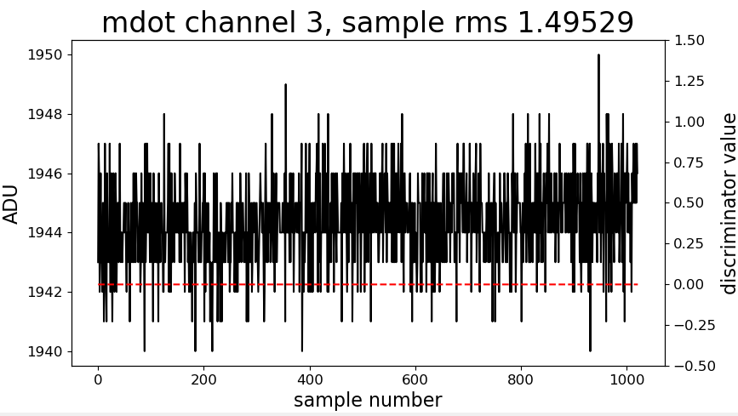
Channel #3, typical noise, with open input

Slide 9
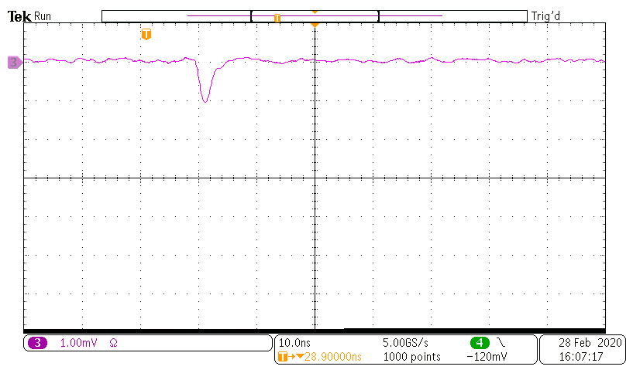
Channel #3, 1mV input
No safe trigger condition found

Slide 10
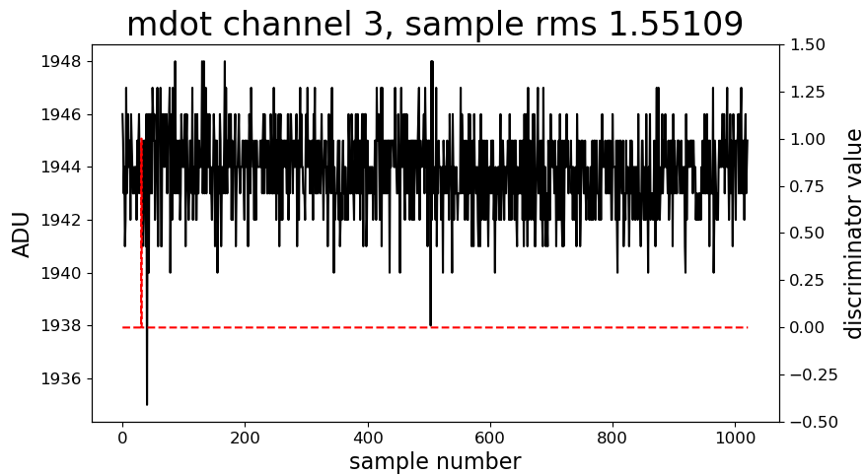
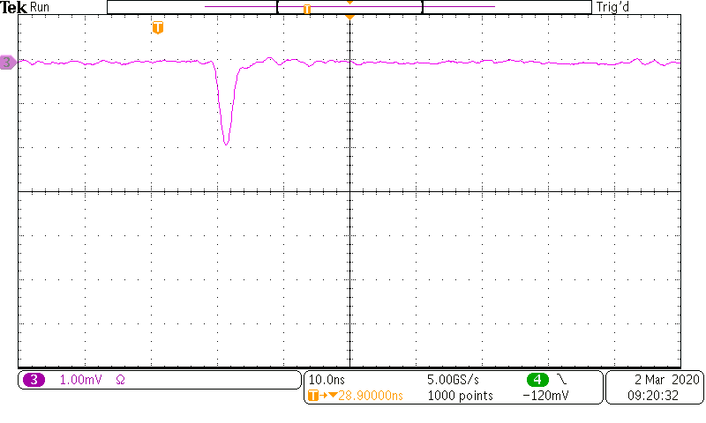
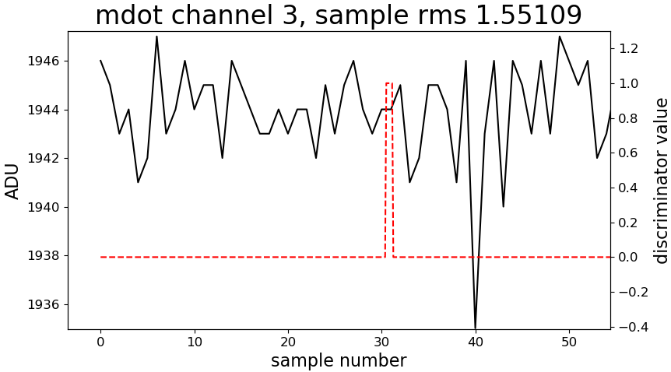
Channel #3, 2mV input
8

Slide 11
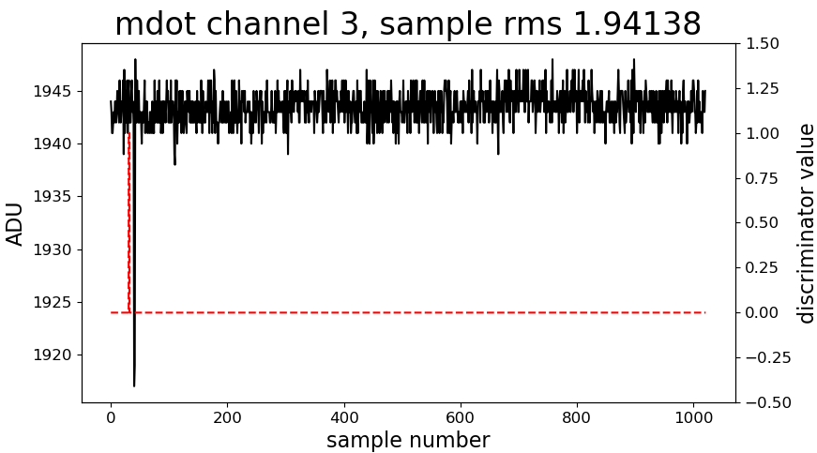
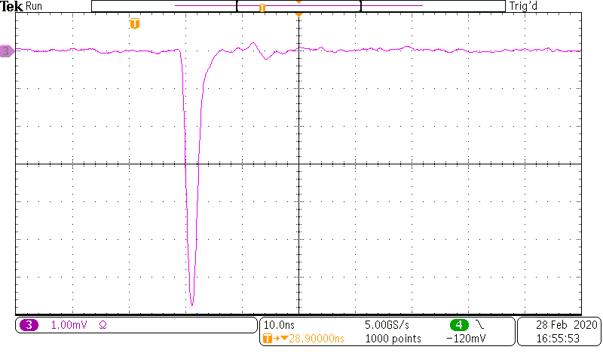
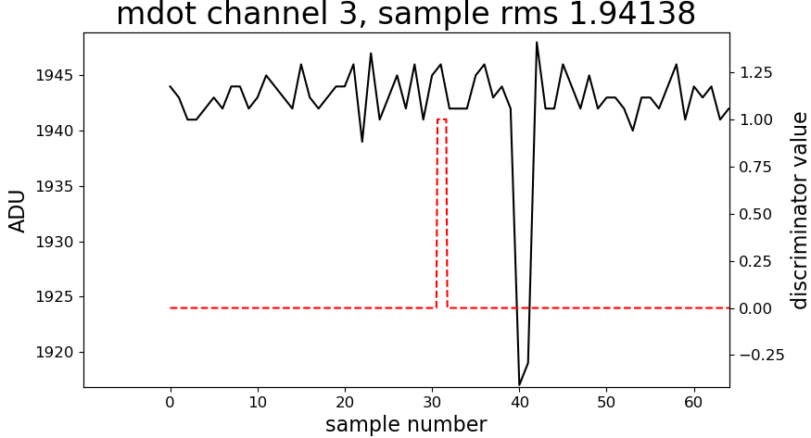
Channel #3, 7mV input
25

Slide 12
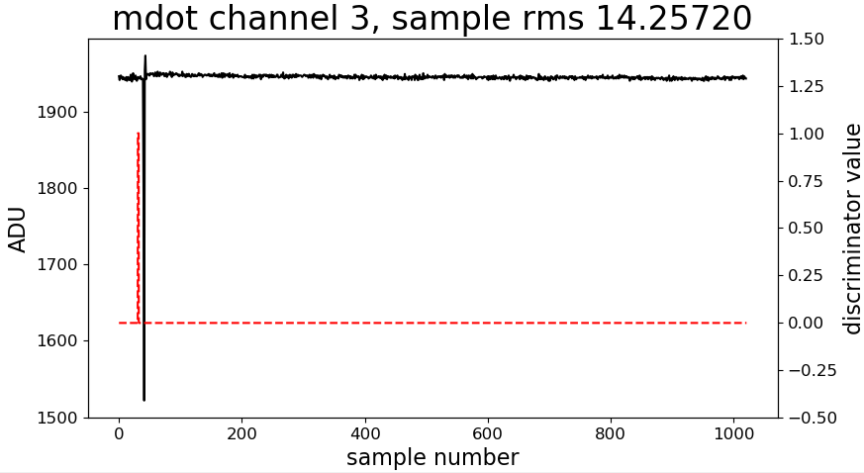
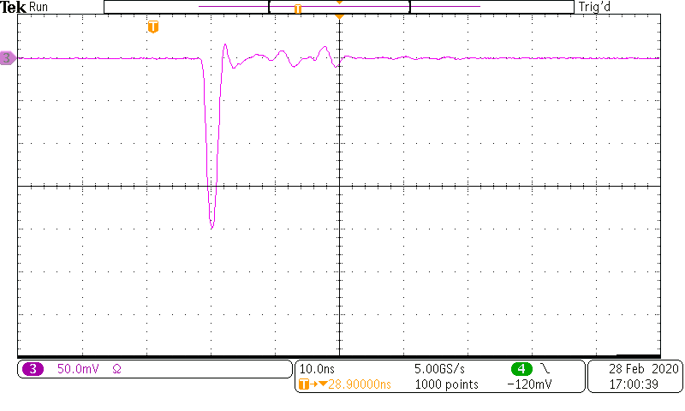
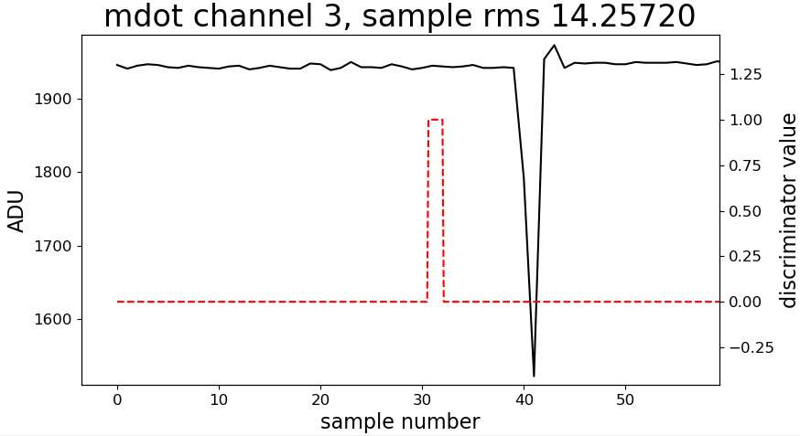
Channel #3, 200mV input
430

Slide 13
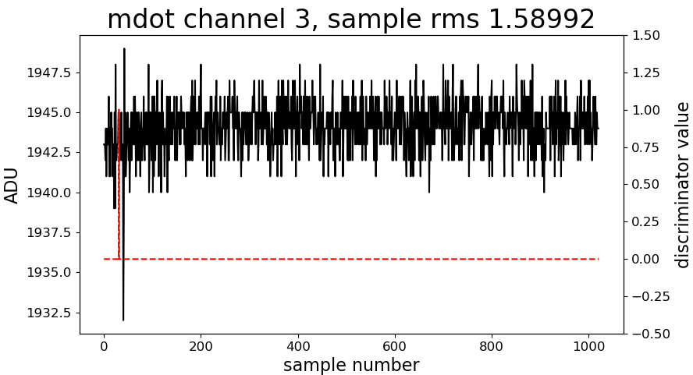
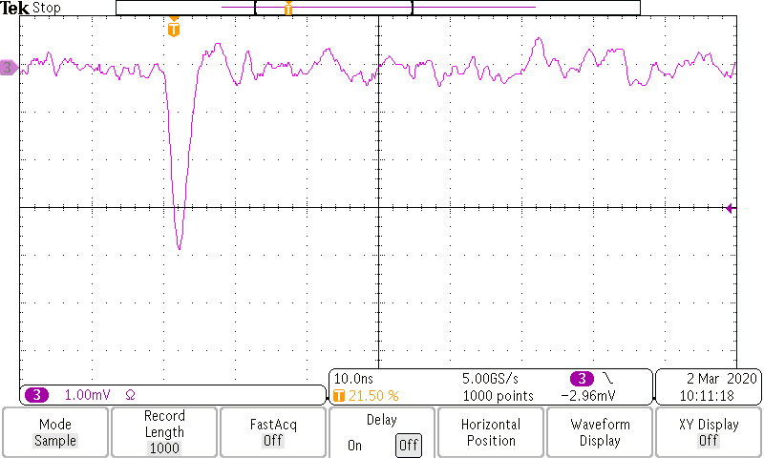
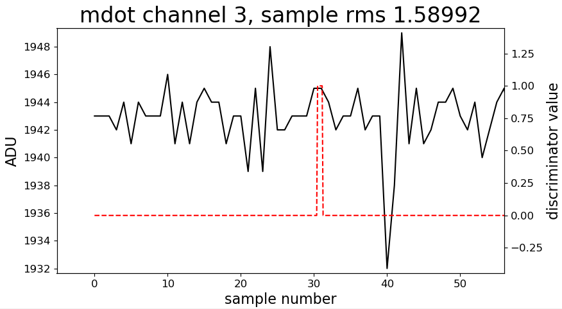
Channel #3, 4mV PMT signal, HV = 567V
typical signal

Slide 14
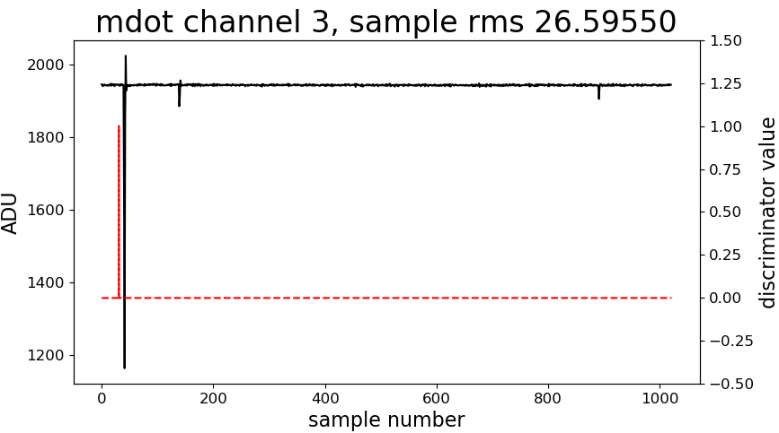
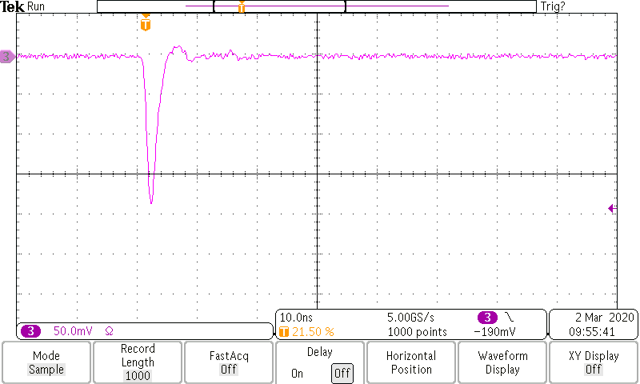
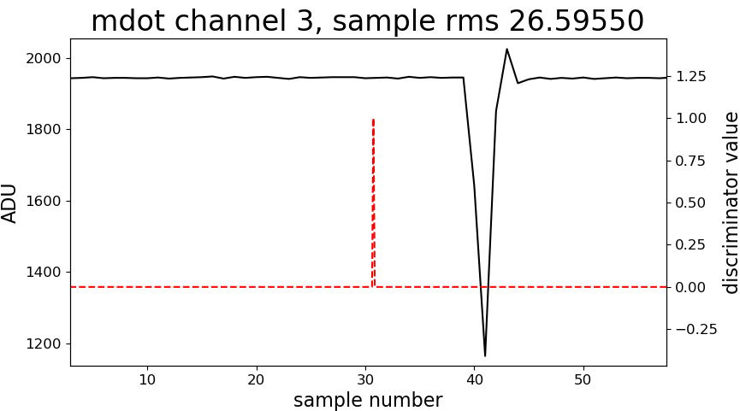
Channel #3, 200mV PMT signal, HV = 846V
typical signal

Slide 15
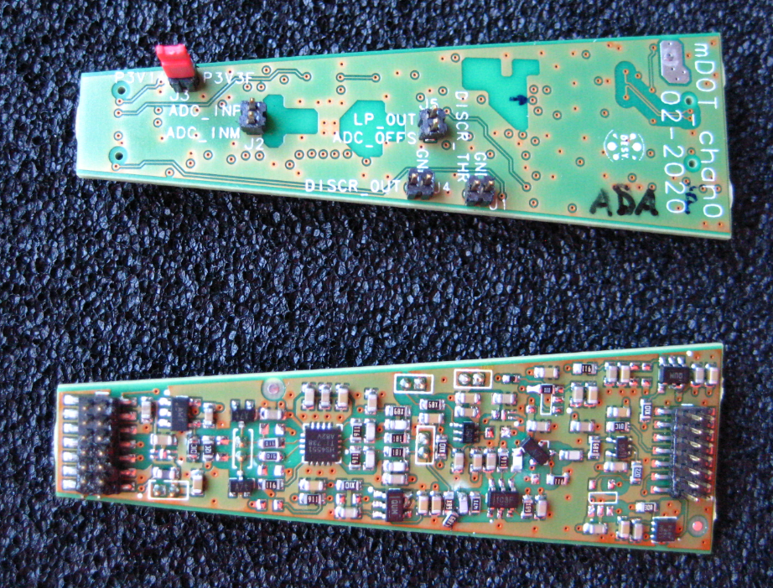
Channel #0, the Piggyback Module
PCB design by Carola Rueger, assembled by Mandy Hemp (DESY workshop)
Current meas.

Slide 16
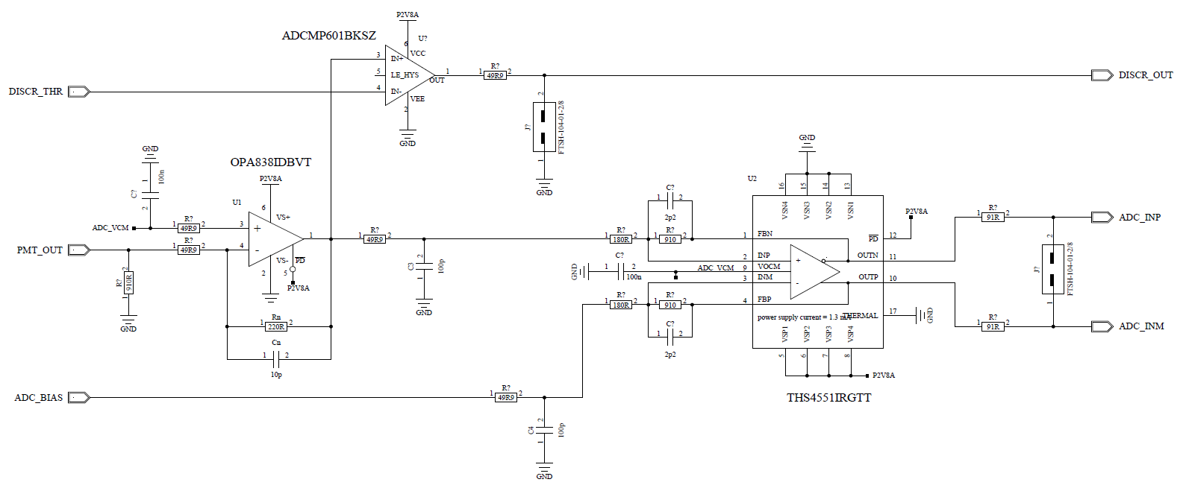
DC-coupled Channel #0, basic Schematic
Comparator
shape
gain_1
overshoot
gain_2
or ADA4940
transimpedance ampl.
single-ended to diff.

Slide 17
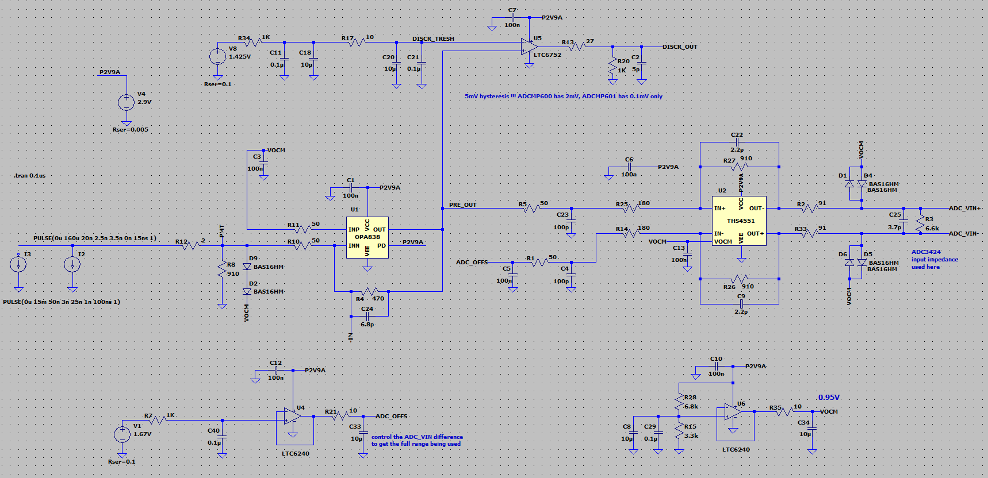
LTSpice Schematic used

Slide 18
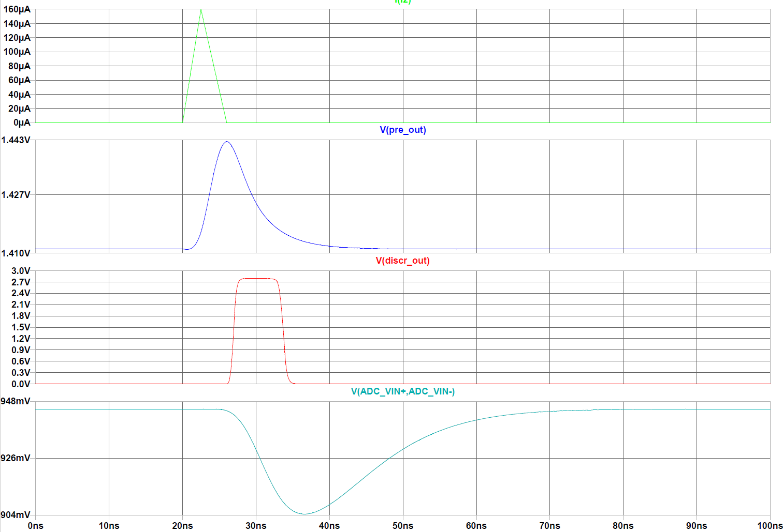
SPE Signal, LTSpice Simulation Results
PMT
~8mV @ 50ohm
Preamp_out
Discr_out
ADC_in

Slide 19
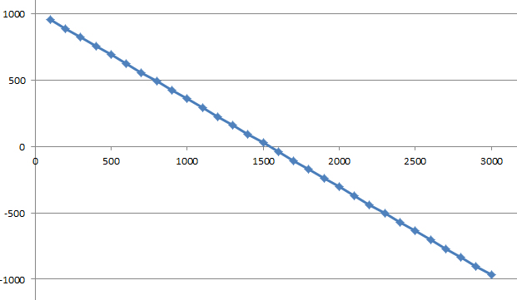
DC Linearity Test
Modules „THS“ and „ADA“, (different, pin-compatible opamps in front of the ADC)
Injecting a DC current 100µA to 3 mA, to get a diff. ADC input voltage of +1V to -1V
20K resistor + 0 to 75V power supply as current source
Voltage vs. current, using two multimeters, …perfectly linear, both for THS and ADA modules
THS
Input current,
µA
ADC input voltage, mV

Slide 20
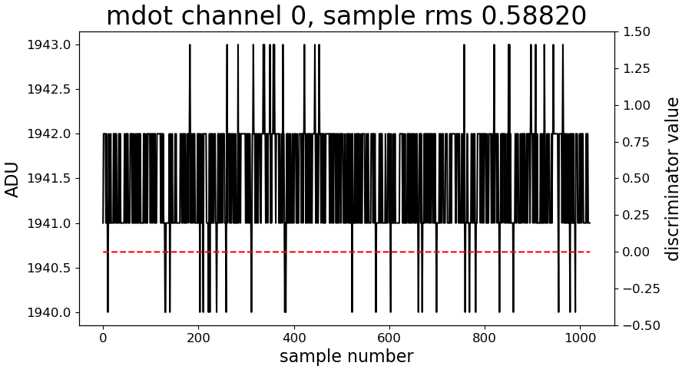
Typical noise, with open input
Using the ADC driver THS4551
Rin=910R, Rn = 470R, Cn=6.8p, LP = 51R x 100p, gain_2 ~ 5, DAC0_e = 44000, DAC1_a = 37200

Slide 21
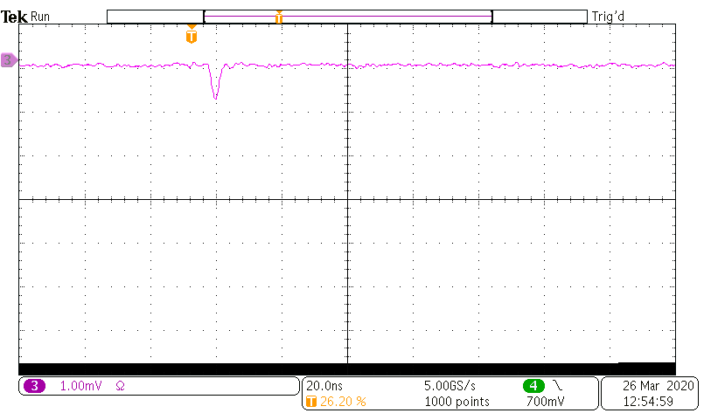
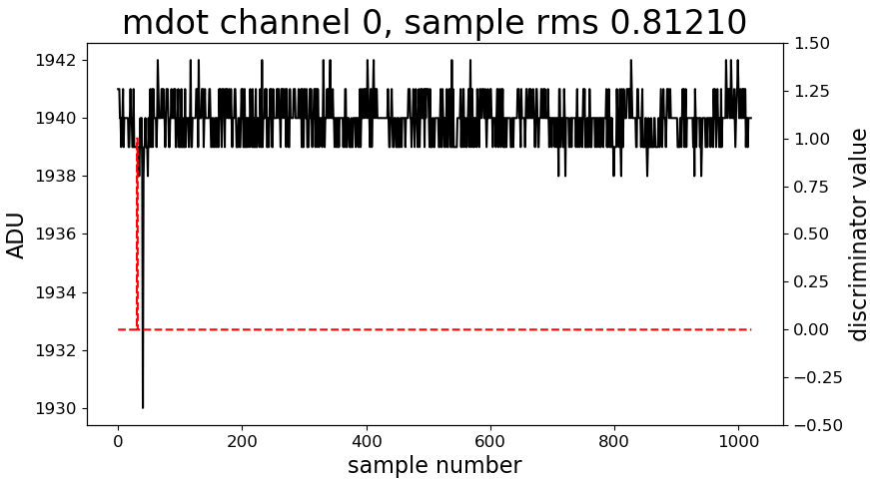
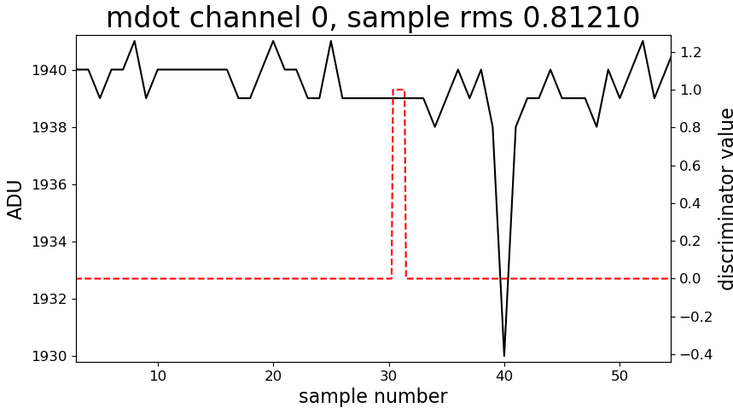
1/10 SPE input (0.8mV pk)
9

Slide 22
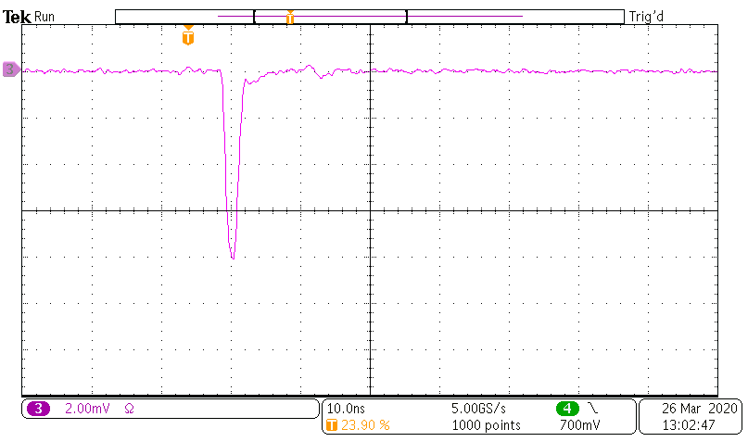
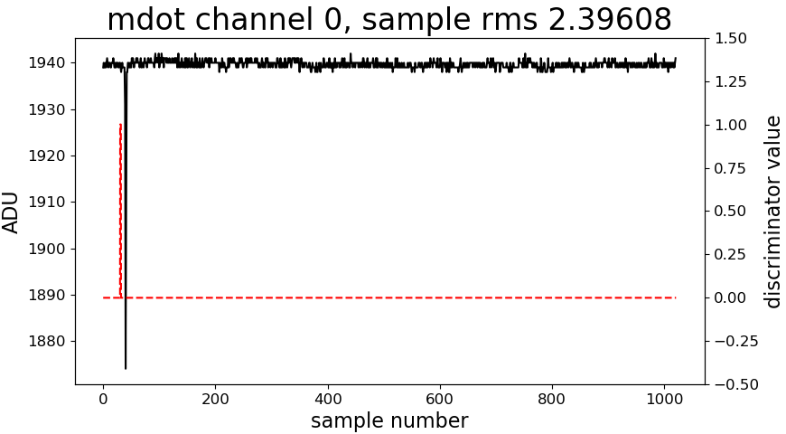
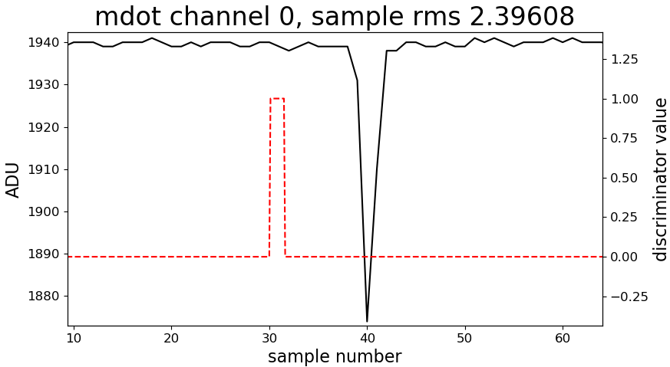
1SPE input (8mV pk)
65

Slide 23
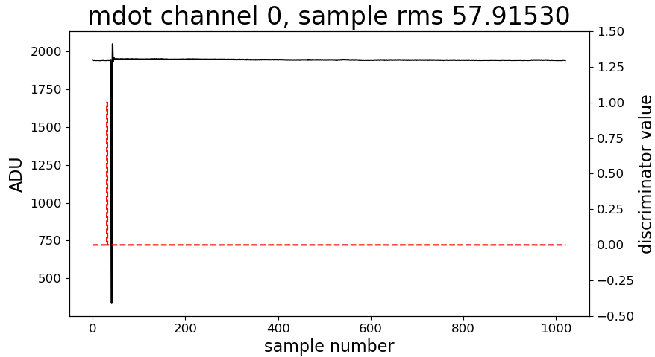
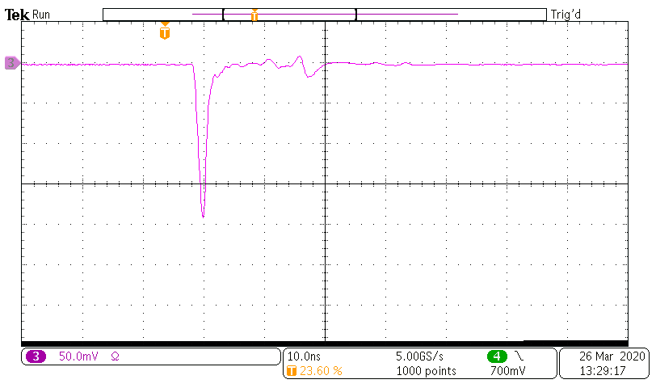
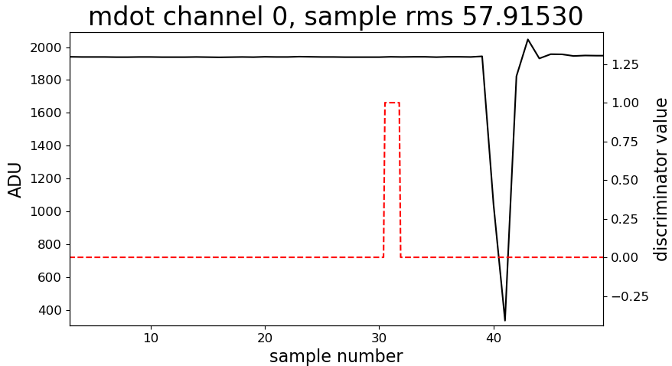
200mV input
1750

Slide 24
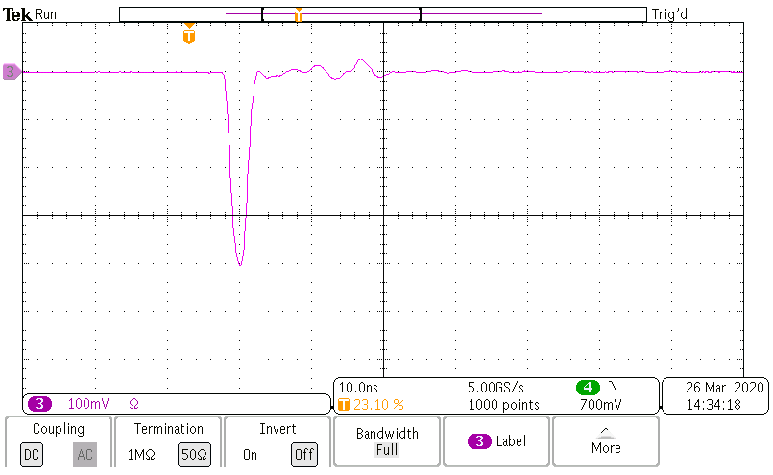
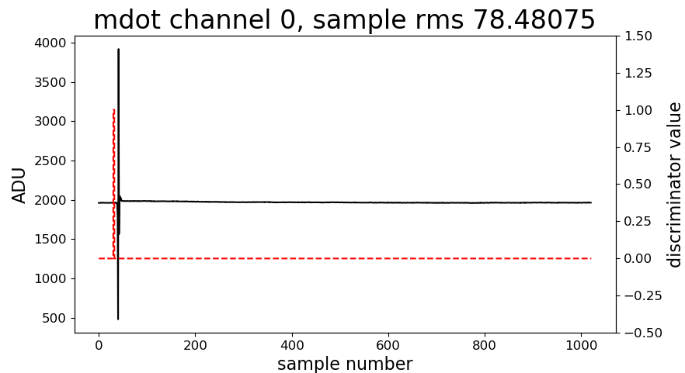
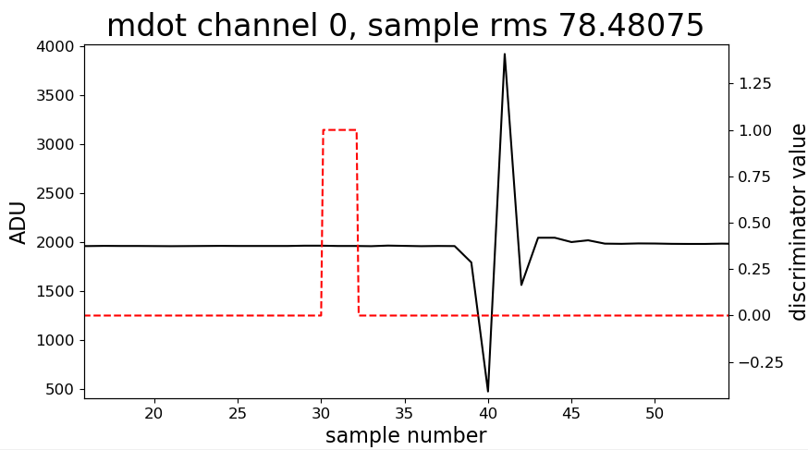
400mV input
Signal shape by ADC-readout script
3500

Slide 25
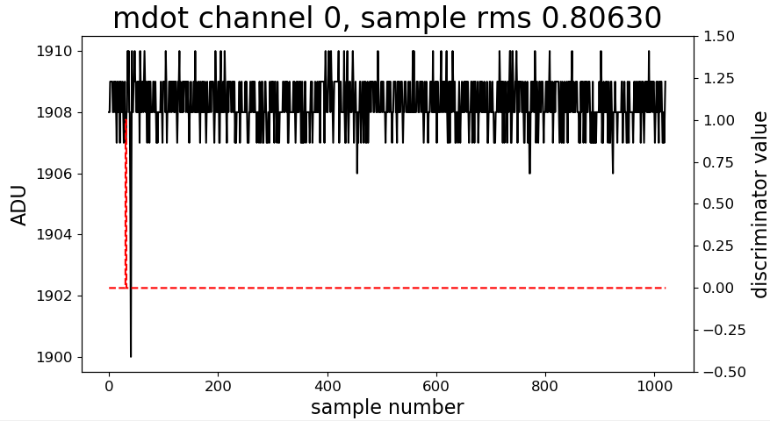
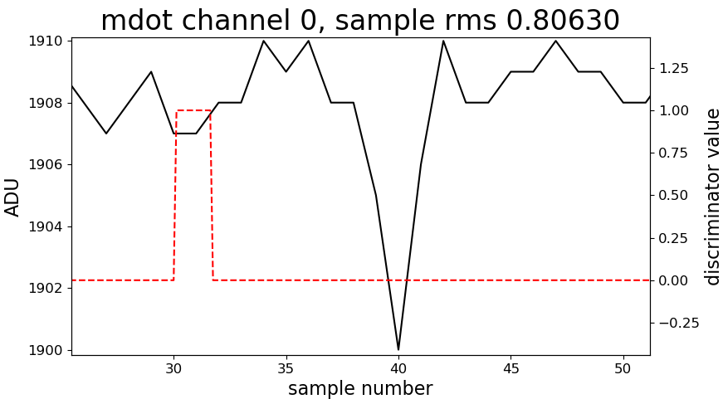
PMT signal, 4mV, HV = 566V
typical signal
8

Slide 26
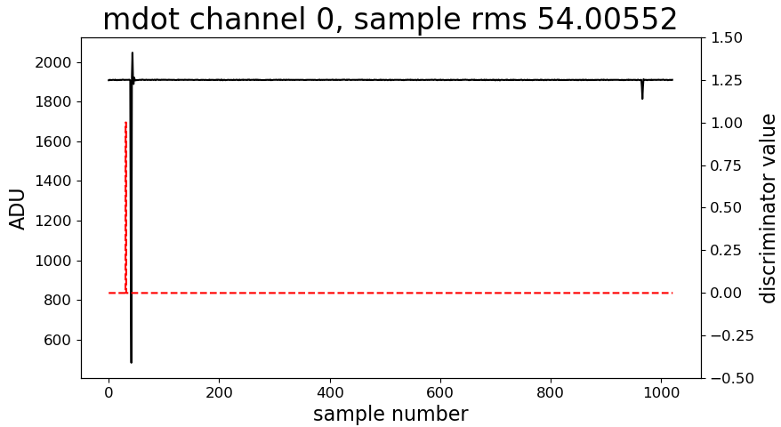
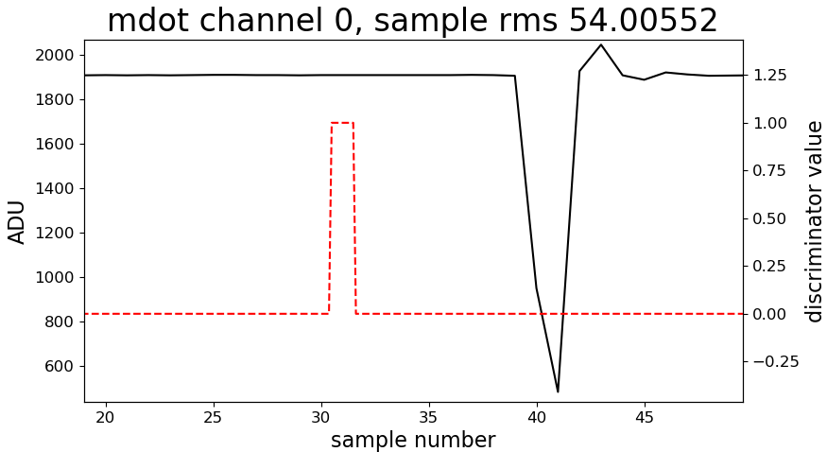
PMT signal, 200mV, HV = 846V
typical signal
1400

Slide 27
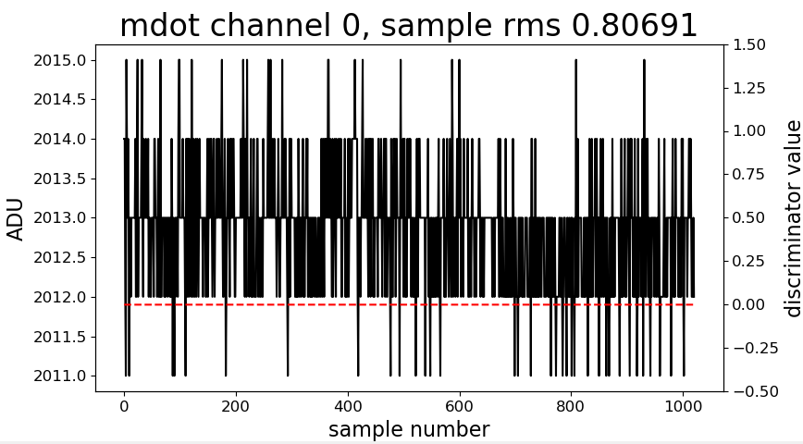
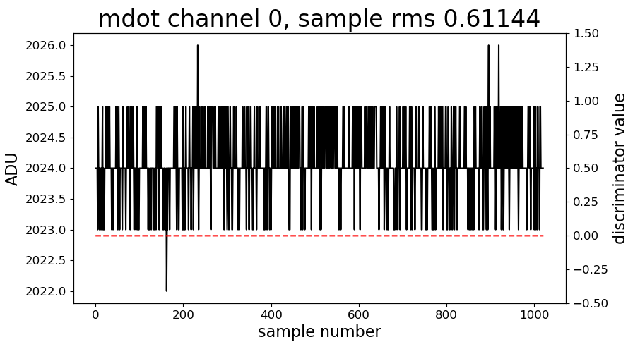
Noise Comparison, Amplifiers THS4551 vs. ADA4940
Singel ended to diff. Amplifier, ADC driver
ADA4940
THS4551

Slide 28
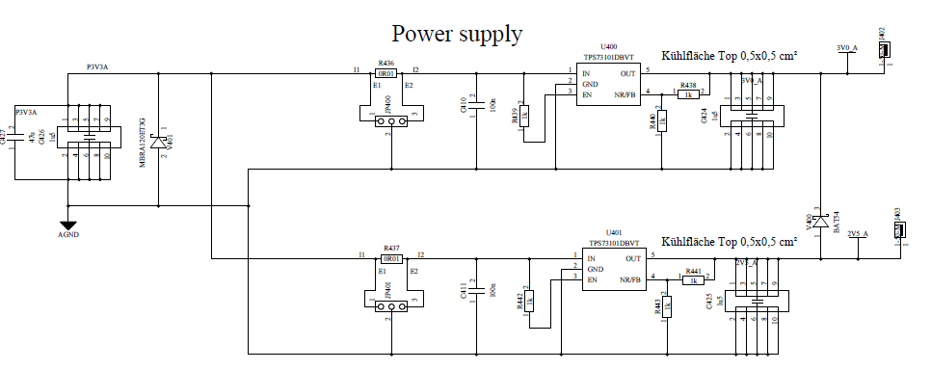
Power Consumption of Channel #3
Used default DAC settings
3.3V * 9.15mA= 30.2 mW
After power supply modification:
3.0V => 27.5 mW
3.0V
3.3V
9.15mA
2.5V

Slide 29
Power Consumption of Channel #0
with default DAC setting
3.3V * 7,56mA + 1mW (1/4 DAC)= 26 mW
After power supply modification:
3.0V => 23.7 mW
mDOM, overall analog power consumption with ADC at 100MSPS:
6*350mW (ADC) + 24*23.7mW (analog chan.)
= 2100mW + 567mW = 2667 mW
~ 111 mW / channel
7.56mA
2.8V
3.3V

Slide 30
Low Temperature Test, first Results
Temperature measurement using sensors on channel #3 and #0
mDOT power off at -60°C (board temp.), fridge was at -70°C
Repowering after 2 hours at -62°C
ICM / mDOT FPGAs, load from flash w/o problems
analog channels 0, 2 and 3 are functioning at -60°C
ADC (FPGA) recalibration was not required
FPGA internal delays are slightly temperature depending

Slide 31
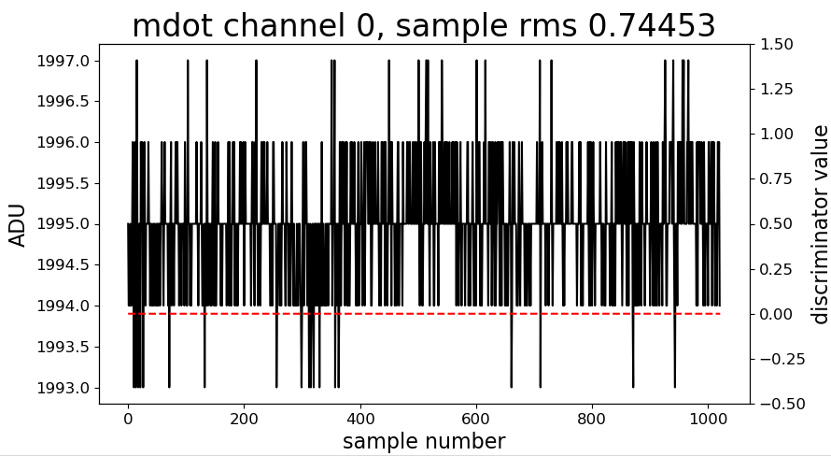
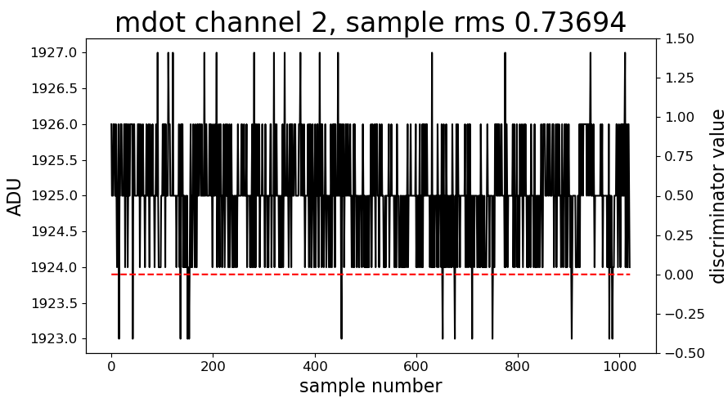
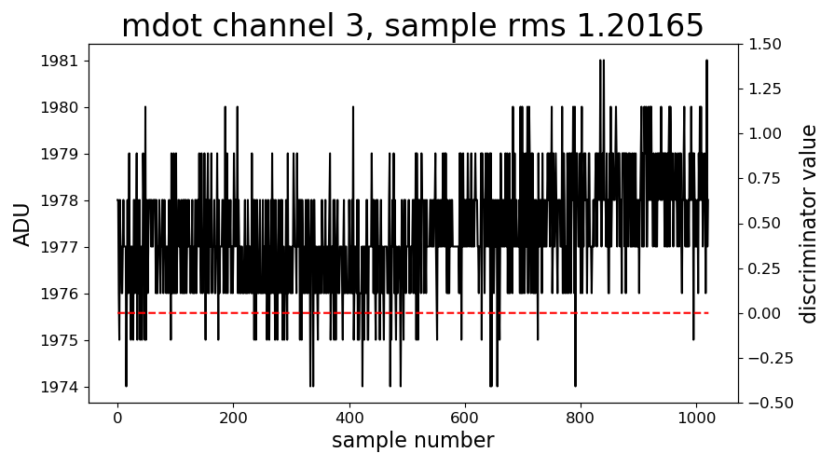
Baseline Noise at -35°C, PMTs connected, HV = off,
ADA4940 version

Slide 32
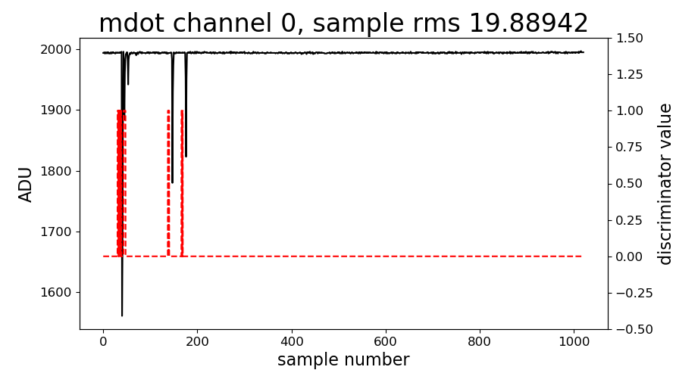
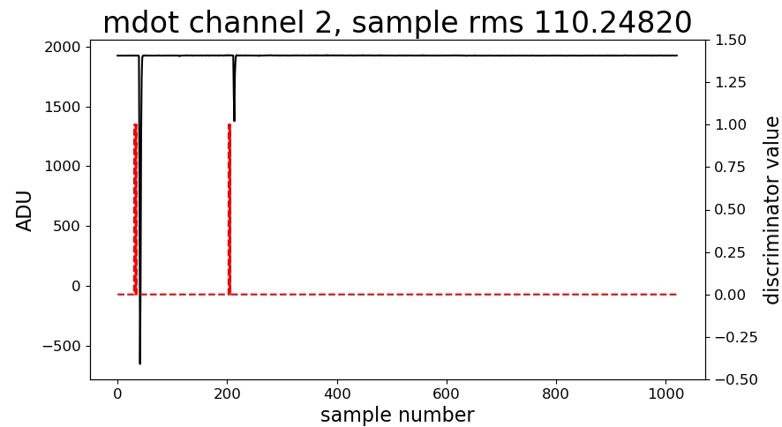
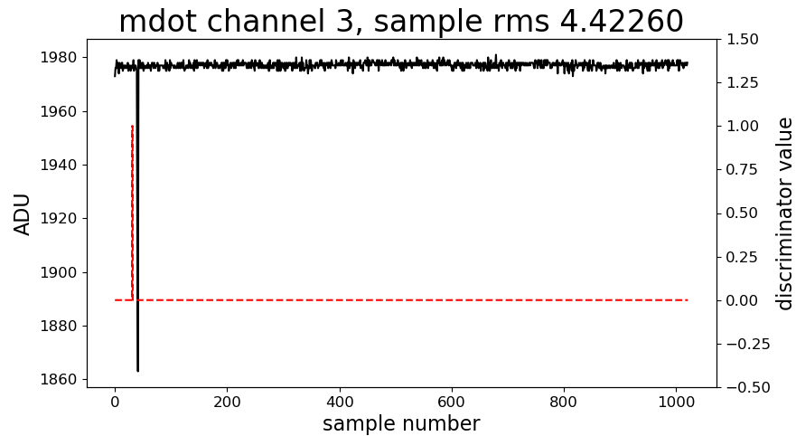
Random PMT Signals at -35°C

Slide 33
Chan_0, Baseline shift vs. Temp., preliminary
Temp. /°C | Baseline | DAC0_e
-15.85 | 1991 | 38500
-9.1 | 1988
-7.5 | 1987
-5.5 | 1987
-4.5 | 1985
+4.0 | 1980
+11.25 | 1975
+16,56 | 1970
Baseline shift of ~-0.5% / 30°C (ADC bins, 21 / 4095)
More careful resistor (gain), V_ref and DAC selection might reduce this value

Slide 34
Comparison, Channel_0 vs. Channel_3
 | Chan_0 | Chan_3 | remark
Input protection | yes | no | To prevent the damage of the preamplifier stage
Coupling, PMT to ADC | DC | AC | Chan_3 with AC-coupling after preamp.
Power consumption | 23.7 mW | 27.5 mW | Assuming 3.0V will be used at mDOM
mDOM, DAC channels | 54 | 192 | mDOM, 9 vs. 26 FPGA pins
Baseline noise | 0.6 | 1.5 | Typical RMS, with open input
Min. trig. thr. | 1/16 SPE | 1/4 SPE | 0.5mV vs. 2mV
Dynamic range | 1/800 (?) | 1/200 (?) | About, to be measured exactly
Test pulse resolution | 16bit | 16bit | DAC resolution
Test pulse width | 1ns * n | 1ns * n | Assuming FPGA – oserdes stage is used, Not yet tested

Slide 35
Channel #0b
Allows to adjust the working point of the preamp stage
Wider output range
More flexible, could also handle positíve pulses
Improved ADC input protection
PCB production started
10 modules will be available in first week of May

Slide 36
Conclusions
The FPGA firmware is very stable, a good starting point for the final design
The transformer based test adapter is useful to get rid of distortions, caused by DC/DC converter + AC-coupled ground loops
All analog channels work in the cold
The mDOT power filtering and PCB design can be copied to the final mDOM design
All channels show a fairly low baseline noise
the piggyback slot allows fast, low cost analog channel optimization
further optimization of R,C values might improve the (partial) linearity

Slide 37
Backup Slides

Slide 38
Channel #2, typical noise, with open input
Rin=910R, Rn = 470R, Cn=10p, LP = 51R x 100p, DAC0_h = 40000, DAC1_c = 18380

Slide 39
Channel #2, 0.5mV input
6

Slide 40
Channel #2, 1mV input
10

Slide 41
Channel #2, 2mV input
17

Slide 42
Channel #2, 4mV input
37

Slide 43
Channel #2, 7mV input
60

Slide 44
Channel #2, 200mV input
ADC input signal
1V
1750

Slide 45
Channel #2, 400mV input
Signal shape by ADC-readout script
ADC input signal
3400
1.7V

Slide 46
Channel #2, 4mV PMT signal, HV = 567V
typical signal
9

Slide 47
Channel #2, 200mV PMT signal, HV = 846V
typical signal
850

