Slide 1
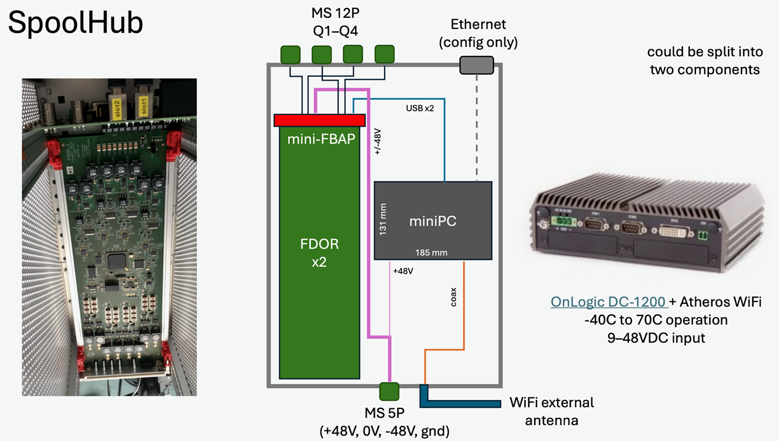
SpoolHub, FDOR & mini-FBAP Modifications?
Sketch by John Kelley

Slide 2
„ERD“
Checking for connector leakage currents BEFORE powering the in-ice module
Precise current measurement at low voltage
Avoid connector-damages by galvanic effects
Being very EMI resistent for stable comms

Slide 3
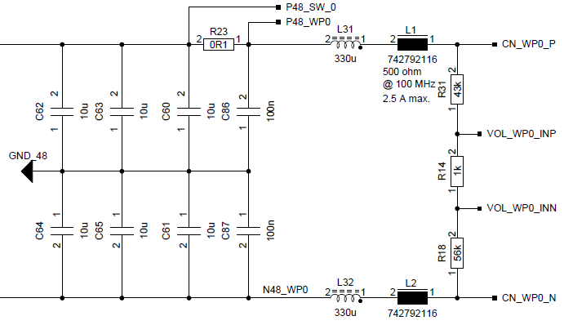
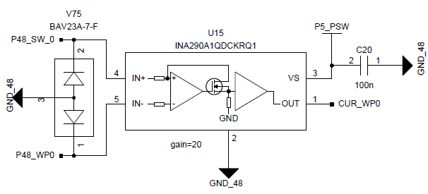
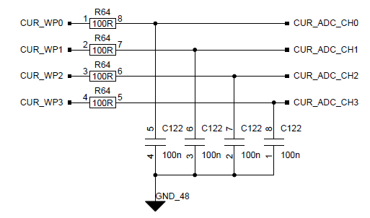
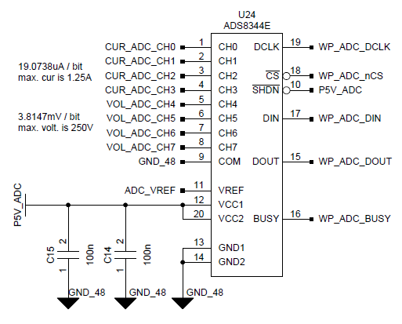
FDOR_3, Wire Pair Current Monitoring
Current shunt
shunt amplifier
filter
+/- 60V
in
+/- 60V
out
16-bit ADC

Slide 4
Connector Leakage Test
Power the modules below 36V (DC/DC power-on threshold)
Measure the current, using the FDOR monitoring hardware
19.1uA / bit, range 0 to 1.24A
Proposal, changing the current shunt from 0.1ohm to 1ohm
1.91uA/bit, range 0 to 124mA
124mA * 150ohm (cable) = 18.6V, @120V ~ max. 12.5W in-ice load before the current measurement gets into saturation
Likely not an issue

Slide 5
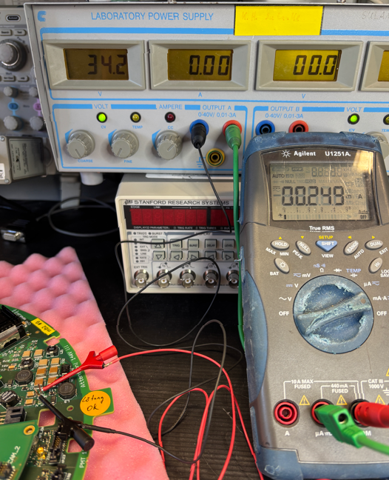
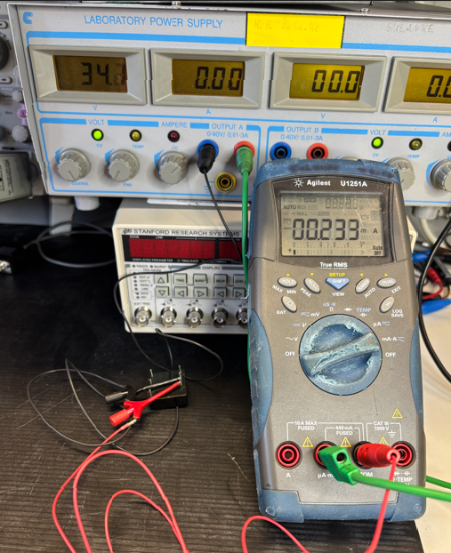
mDOM Mainboard Current at 34V
249µA for the mainboard, 233µA at the pure DC/DC
Difference by the 2M resistance on the mainboard, 34V / 2M = 17 µA
mainboard
Pure DC/DC

Slide 6
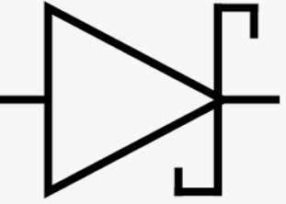
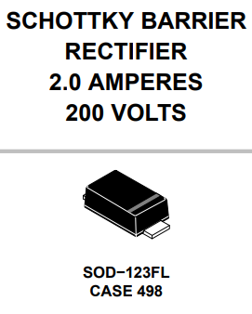
Wire Pair Voltage, How to deal with 30V vs. 120V?
running one wire pair of the FDOR at ~30V + low current mode
switch to an unmodified wire pair after a successful leakage test
Using a relais ?
Or combining wire pairs #0,1 by using 4 diodes for decoupling?
E.g. replacing ferrites L1..L4
Wire pair 0 and 1 could get connected at the DSUB cable connector or on the FDOR by patch wires
ferrite

Slide 7
Wire Pair Voltage, How to deal with 30V vs. 120V, cont.
Due to parallel connected wire pairs, one termination should be removed (R165, R166)
termination
DSUB9
conn.-side
Comms
ADC / DAC-side

Slide 8
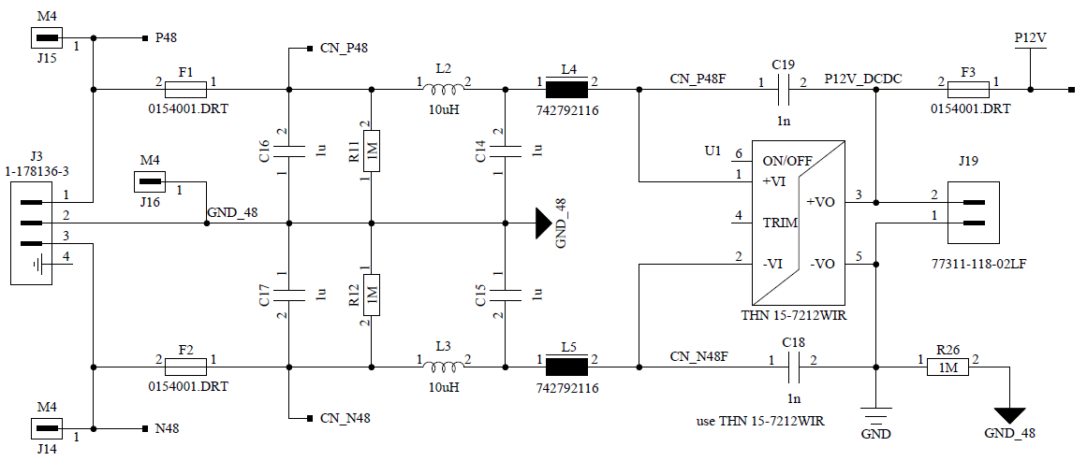
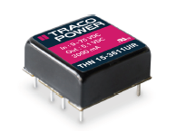
How to get 30V at Wire Pair #0?
Temporarily changing the string input voltage at the mini-FBAP
Changing the mini-FBAP DC/DC required
use pin-compatible UIR-type (14-160VDC) input voltage range
mini-FBAP
12V FDOR card power supply
to string power supply
Change to
THN 15-7212UIR

Slide 9
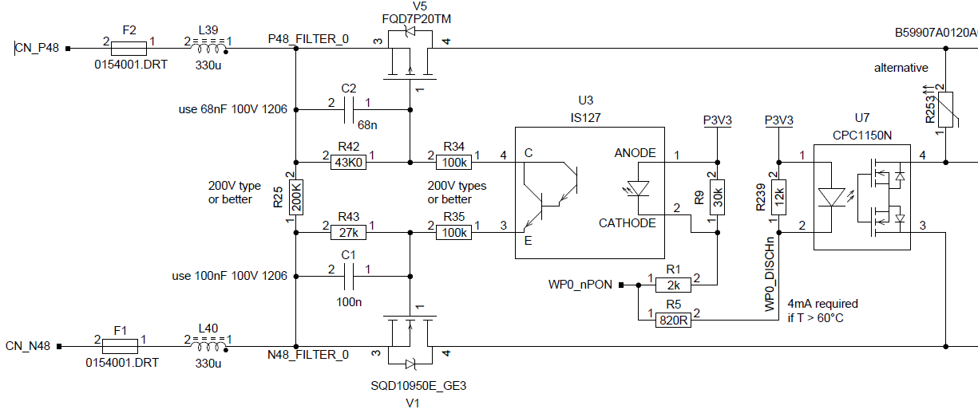
How to get 30V at Wire Pair #0, cont.
Alternatively, modifying the power switch stage of wire pair #0
DSUB9
conn.-side

Slide 10
Conclusions
By modfying parts of the FDOR card and combining two wire pairs within the DSUB9 cable connector, accurate leakage current measurements should be possible
A setup, to get realistic leakage current values in water might be useful
Once the whole setup (shielded box) is available, use artificial EMI sources, when running communication tests

