Slide 1
In Water Operations in the 2025 / 26 Season, SpoolHub Power & EMI Reduction

Slide 2
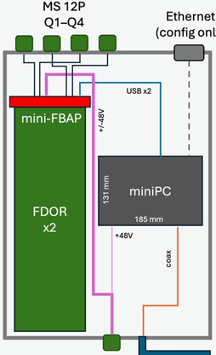
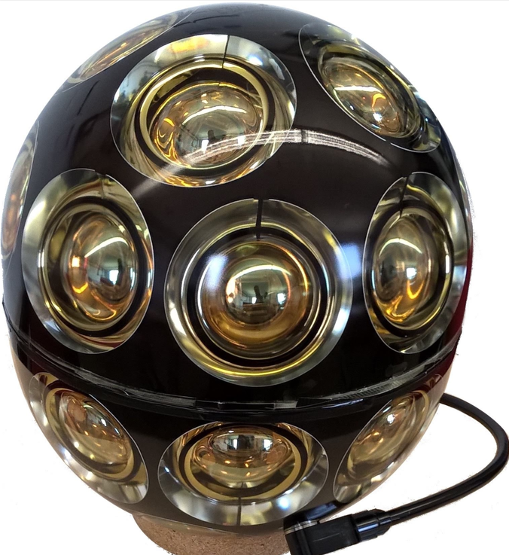
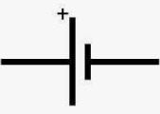
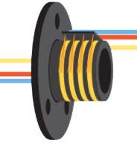
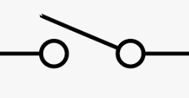
SpoolHub-Powering by Batteries
Fully decouple the SpoolHub from the EMI generating spool-drive
+/- 48 battery power over the slip ring
miniPC powered by the mini-FBAP
temperature-isolated box
2x Battery
12V
Heater
Slip ring
Temp.
control
Charger
SpooHub, by J. Kelley
110 VAC

Slide 3
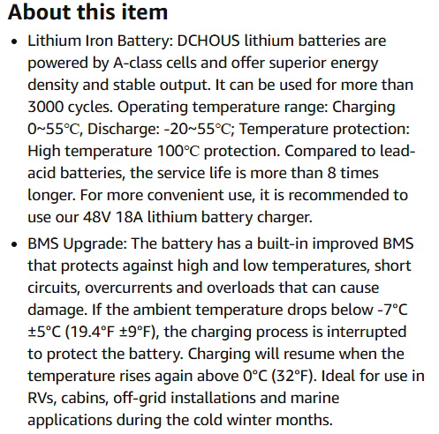
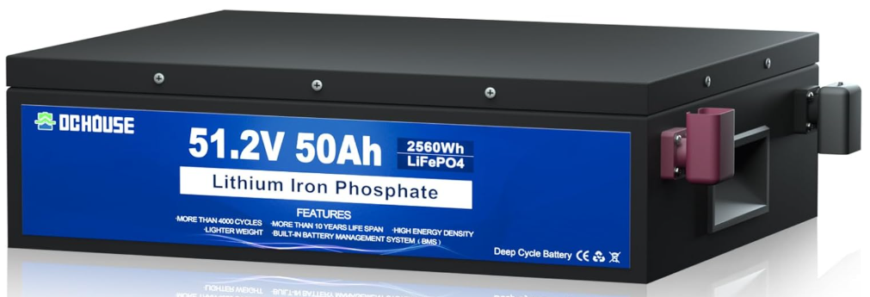
Battery
Model DCHOUSE
4.92“ (125mm)
13“ (330mm)
17.21“ (440mm)

Slide 4
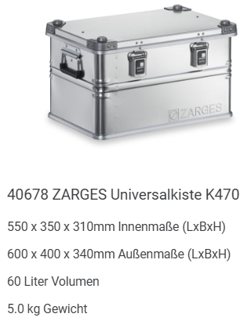
Box
Model Zarges 40678

Slide 5
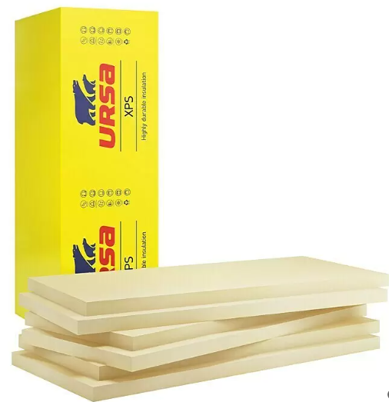
Insulation
URSA XPS D N-III-L
125 x 6 x 3 cm
-50°C to +70°C
Extruded Polystyrol (XPS)
300 kPa at 10% compression

Slide 6
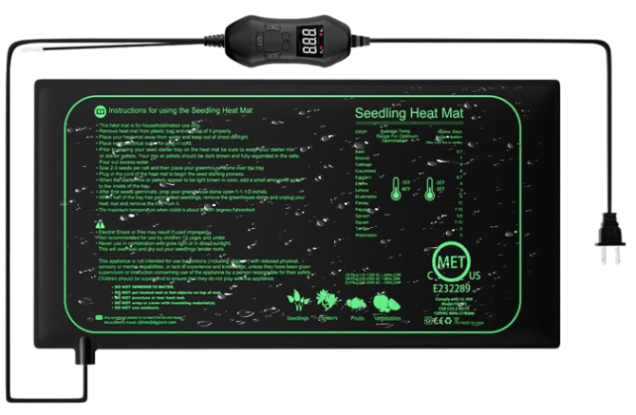
Temperature Control
Model Silkwish 50 W

Slide 7
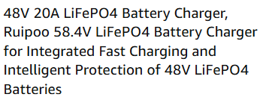
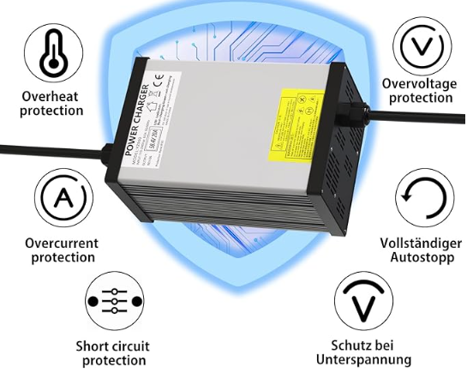
Charger
Model YZ900

Slide 8
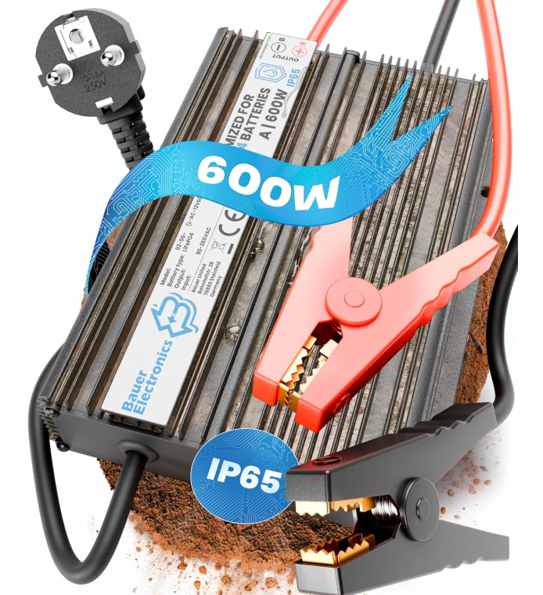
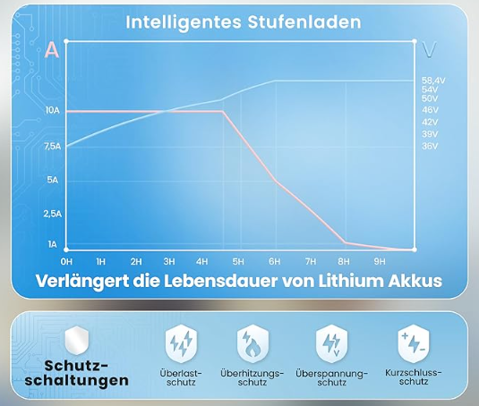
Charger
Model Bauer 02-50

Slide 9
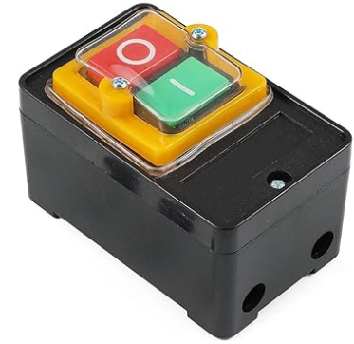
Charger Switch
Model ANCLLO KAO-10KH

Slide 10
Battery Box, Components
preliminary
item | Manufacturer-ID | Remark
Box | Zarges 40678 | 600 x 400 x 340 mm
Insulation | Ursa XPS D N-III-L | Rigid foam, 30mm
Batteries | DCHOUSE 48V 50Ah | LiFePO4, Rechargeable battery with more than 4000 cycles, Built-in BMS (battery Management System), -20 to +55℃, 440 x 125 x 330 mm
Charger | Bauer LiFePO4 58.4 V 10 A | Fanless, Intelligent charging
Heating | Silkwish 50 W | with Thermostat - 52.5 x 25 cm
Switch | Kao-10KH | waterproof

Slide 11
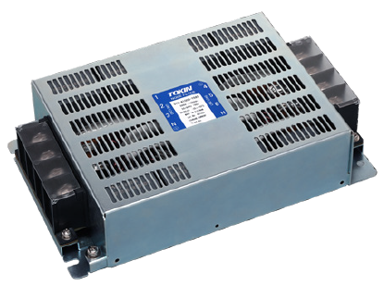
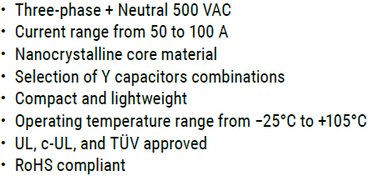
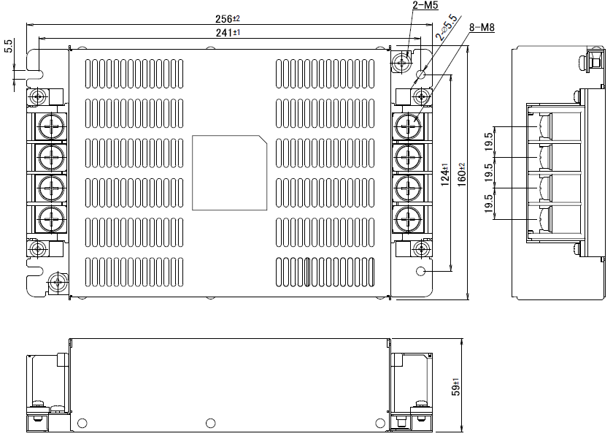
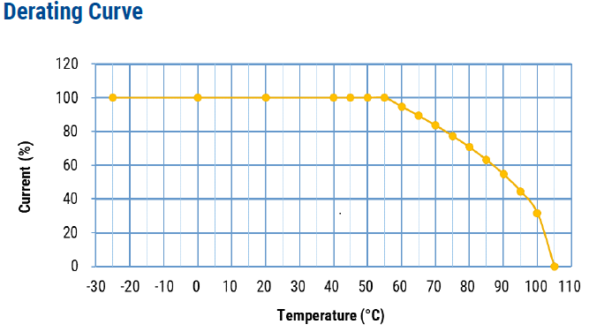
Spool Drive, EMI Filter
Model KEMET GTX (e.g.)
To prevent the long spool drive cable acting as an antenna, causing EMI

Slide 12
Conclusions for the in Water Operations
big EMI related comms issues have been seen in the season 24/25
Comms failed immediatly when the spool drive was running
there is no realistic test setup in the North for testing the in water operations
We should isolate the SpoolHub from the spool drive as much as possible
Using batteries, we can cut any ground / shield connection to the spool drive
Capacitive coupling by the slipring negligible?
The battery based power supply can be built completely, by using off the shelf components
the costs: ~2000 €
Additionally, installing a good EMI filter in front of the spool drive would be useful
Decision is needed soon!

