Slide 1
In Water Operations in the 2025 / 26 Season, SpoolHub Cabling

Slide 2
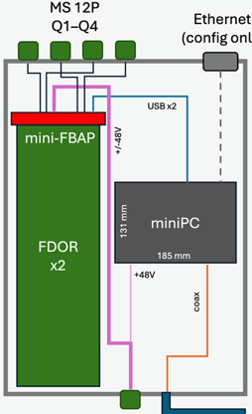
SpoolHub-Powering by Batteries
Fully decouple the SpoolHub from the EMI generating spool-drive
+/- 48 battery power over the slip ring
miniPC powered by the mini-FBAP
temperature-isolated box
2x Battery
12V
Heater
Slip ring
Temp.
control
Charger
SpooHub, by J. Kelley
110 VAC

Slide 3
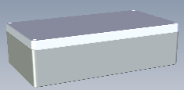
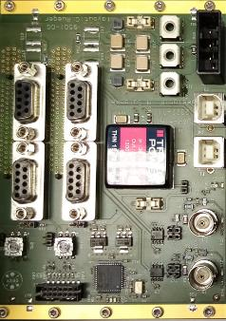
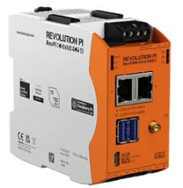
SpoolHub
miniPC powered by the mini-FBAP
RS 485
Quad #1
Paro
4W+
12V
ethernet
30W
USB
96V
Enclosure 400x230x111 mm

Slide 4
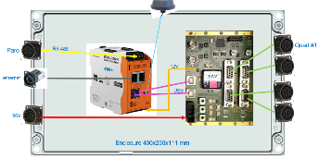
Spoolhub, Cables
Item | Conn. #1 | Conn. #2 | Cable type | Length | Comment
Paro to RevPI 4 | PT07A-14-5S | Cable end sleeve | 969M101-22-2TPS-025 | 0.5m | Cable type / length is variable
Mini-FBAP to quad-conn. | DSUB9-male, Norcomp 772-E09-103R001 or Phoenix VS-09-ST-DSUB-EG or TE 5-747904-2 (or -5) | PT07A-14-12S | 969M101-22-2TPS-025 | 0.5m | Cable type / length is variable, DSUB9 housing: Molex 173111-0496, -35°C to 125°C
96V power input to FBAP-mini | PT07A-14-5P | 1-178128-3 | 969M101-14-3-050 | 0.5m | Crimp pins 1-917511-2 14AWG, cable type / length is variable
Ethernet connection | Weidmuller 1018790000 incl. protection cap | RevPI 4 built-in | Telegaertner TG 100007966 | 0.5m | Cat6A, -40°C to +75°C, see Weidmuller spec., reduce (milling) the wall thickness down to 3mm
USB-A to USB-B cable | USB-A male | USB-B male, right angle, down (!) pointing | DeLock 84809 | 0,5m | Temperature range?
RevPI 4 power cable | Molex 22-01-3027 Crimp pins 08550102 | Cable end sleeve | Silicon, stranded, twisted, flex 22AWG, | 0.5m | FBAP-mini, J19, Molex 22-29-2021
WLAN-Antenna TANGO23/0.5M/SMAM/S/RP/19 | n.a. | SMA plug (is part of the antenna) | 50ohm coaxial | 0.5m | Antenna Through Hole Mount, WiFi, WLAN, 2.4 GHz to 5.9 GHz, 5 dBi,

Slide 5
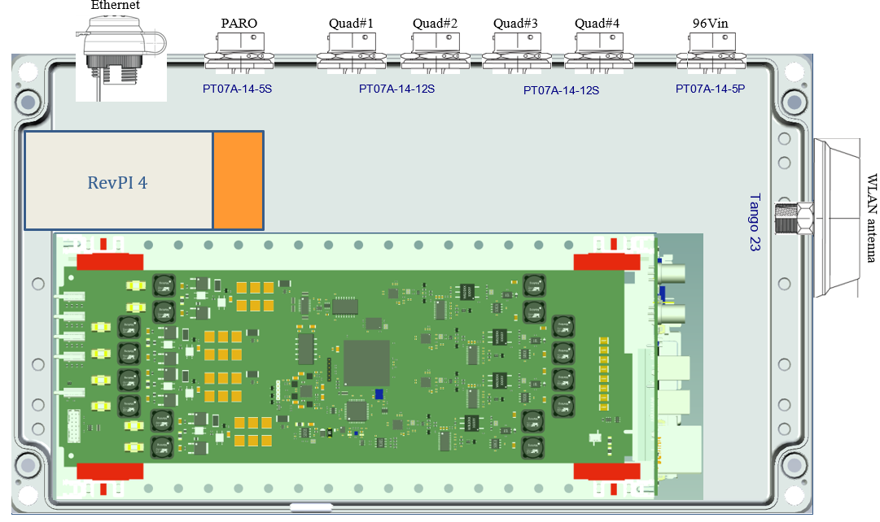
SpoolHub, Connector Arrangement #1

Slide 6
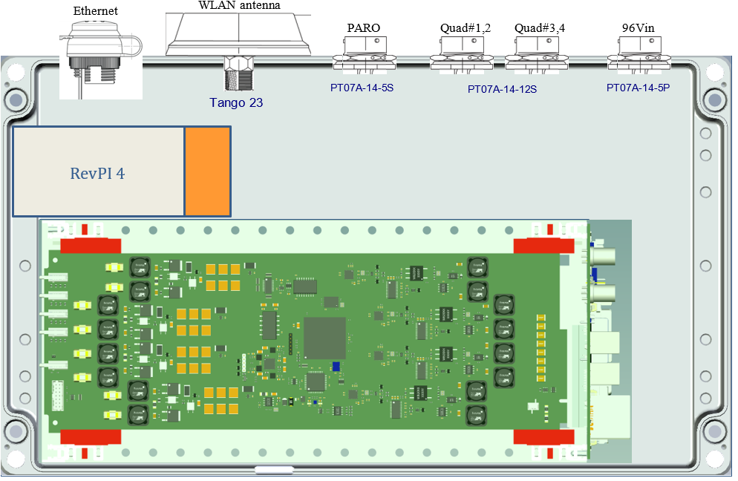
SpoolHub, Connector Arrangement #2

Slide 7
Spoolhub, Status
Available
enclosure
FBAP-mini (incl. new 30W DC/DC)
FDOR cards
MS connectors (?)
Panel mount ethernet connector (?)
Industry PC „RevPI connect 4“, WLAN | 8GB | 32GB
USB cabling
Ordered
Mini-crate parts by nVent | Schroff
Still open
Mini-crate assembly
Cable (-conn.) details
WLAN antenna
Enclosure, connectors holes …

Slide 8
Battery Box, Status
Available
Zarges aluminum box, 600x400x340 mm
2x LiFePO4 battery, 48V 50Ah, with built-in BMS (Battery Management System)
1x battery charger
2x heating mats, 50W
Charger on/off switch
Open items
Thermal insulation
second battery charger
Internal cabling
External connectors
External cabling

